Slide 1
Understanding Community Cultural Wealth to Advance Rural Healthcare
Ira E. Murray, PhD
May 25, 2022

Slide 2
Agenda
Introduction
Community Cultural Wealth
Community Cultural Wealth and Healthcare
Building a Strong Corporate Culture
Ira E. Murray, PhD

Slide 3
“About a third of our population is African American; African Americans have a higher incidence of maternal mortality. So, if you correct our population for race, we’re not as much of an outlier as it’d otherwise appear…For whatever reason, people of color have a higher incidence of maternal mortality.” – Senator Bill Cassidy (LA)
Ira E. Murray, PhD

Slide 4
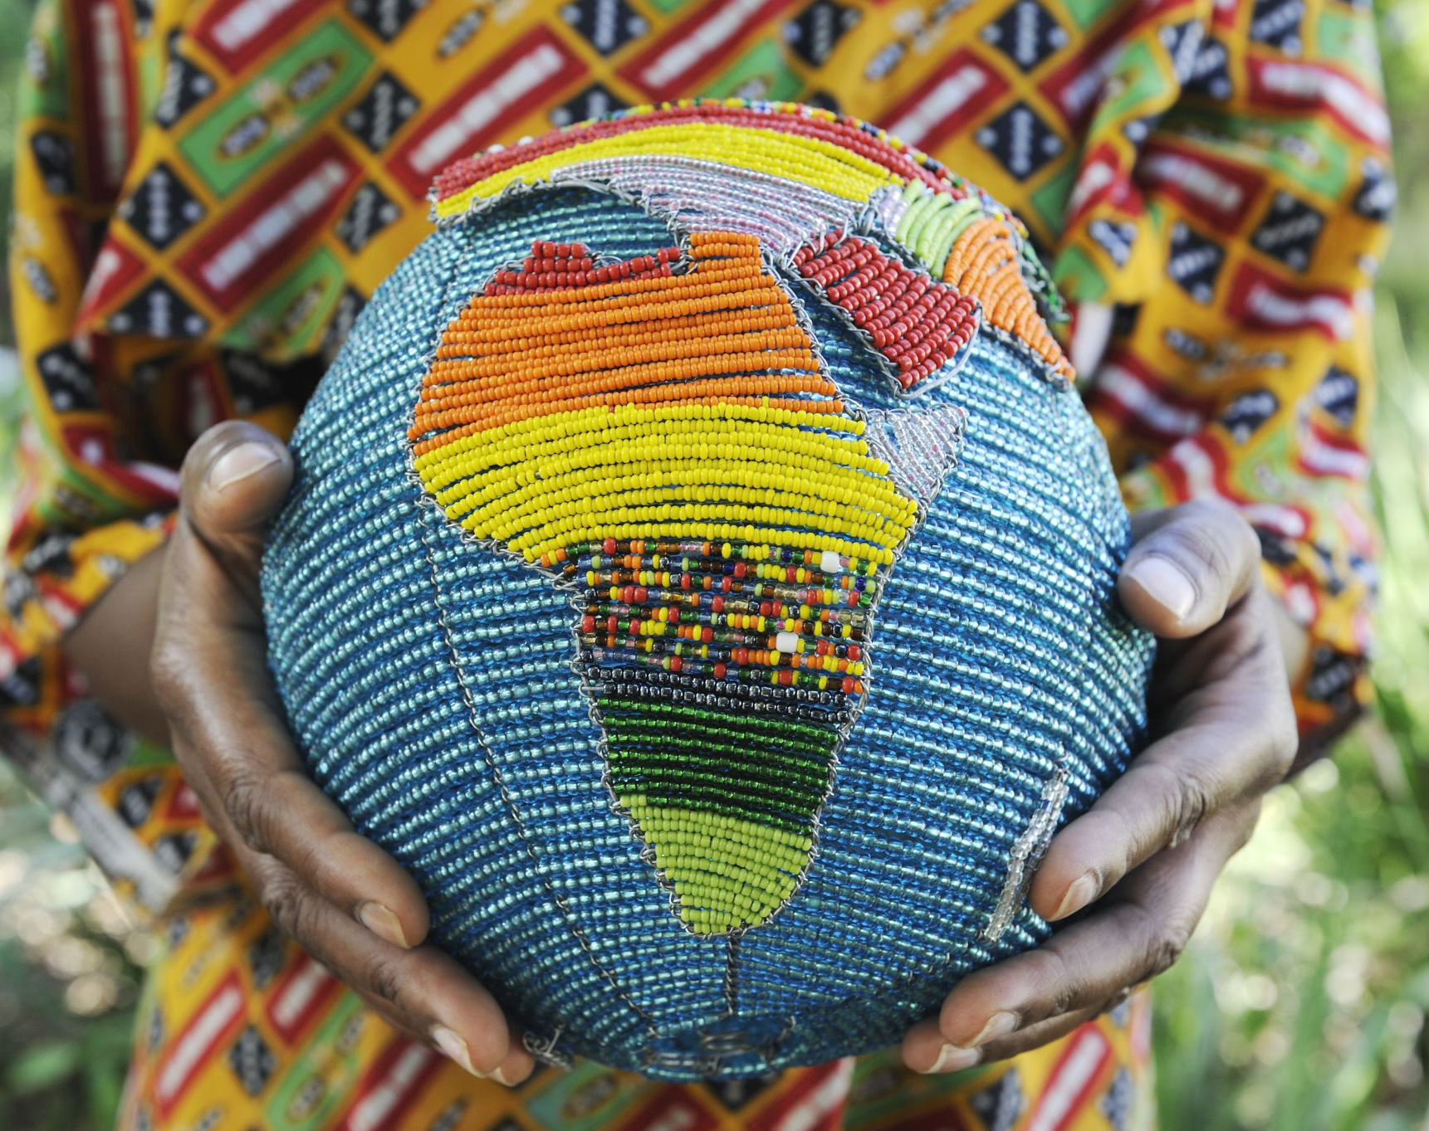
Community Cultural Wealth
Ira E. Murray, PhD

Slide 5
Community Cultural Wealth (Yosso, 2005)
Cultural Capital
“Accumulation of cultural knowledge, skills and abilities possessed and inherited by privileged groups in society.”
Cultural – Social - Economic
Based on “standards” established by dominant groups
Power and privilege maintained by restricting access
Community Cultural Wealth
Shifts focus to non-dominant communities
Centering the experiences of non-dominant communities reveals accumulated assets and resources in their histories and lives
Array of knowledge, skills, abilities, and contacts possessed and utilized to survive and thrive
Ira E. Murray, PhD

Slide 6
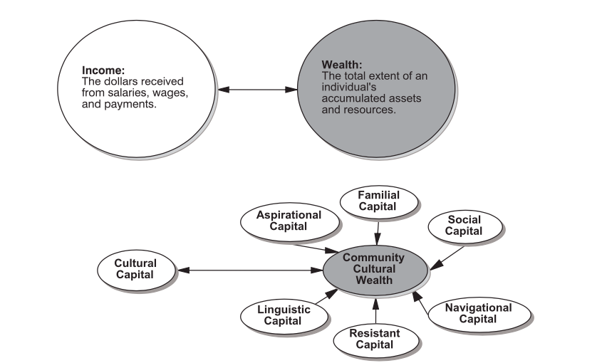
Community Cultural Wealth
Yosso (2005)
Ira E. Murray, PhD

Slide 7
Aspirational Capital
The ability to maintain hopes and dreams for the future, even in the face of real and perceived barriers
KEY QUESTIONS
What health outcomes are important to this community?
What barriers to achieving these outcomes exist (real or perceived)?
How has this community, historically, overcome healthcare barriers?
What does a “healthy” community look like for this community?
Yosso (2005)
Ira E. Murray, PhD

Slide 8
Linguistic Capital
The intellectual and social skills attained through communication experiences in more than one language and/or style
KEY QUESTIONS
How do people in this community talk about health and wellness?
What ways of communicating are important in this community?
Yosso (2005)
Ira E. Murray, PhD

Slide 9
Familial Capital
Cultural knowledges nurtured among kin that carry a sense of community history, memory and cultural intuition
KEY QUESTIONS
What stories/experiences with healthcare are passed down from generation to generation?
How does family history impact views on healthcare and wellness?
What family members have the most influence on views and behavior?
Yosso (2005)
Ira E. Murray, PhD

Slide 10
Social Capital
Networks of people and community resources providing instrumental and emotional support to navigate through society’s institutions
KEY QUESTIONS
What are the trusted institutions in this community? How do we build trust with those institutions?
What types of support are most valued and effective within this community?
Who are the gatekeepers and how do we work in partnership with them to advance health access and equity?
Yosso (2005)
Ira E. Murray, PhD

Slide 11
Navigational Capital
Skills to maneuver through social institutions not created with non-dominant communities in mind
KEY QUESTIONS
What practices/initiatives have been successful in connecting this community with healthcare?
How has this community experienced navigating the healthcare system in the past? What skills have they developed to help navigate the system?
How might the system be changed to better accommodate and engage this community?
Yosso (2005)
Ira E. Murray, PhD

Slide 12
Resistant Capital
Knowledge and skills fostered through oppositional behavior that challenges inequality
KEY QUESTIONS
Why might this community distrust healthcare professionals and institutions?
How has distrust shaped behavior?
How can we acknowledge this history and adapt our systems to this behavior?
Yosso (2005)
Ira E. Murray, PhD

Slide 13
Community Cultural Wealth and Corporate Culture

Slide 14
Community Cultural Wealth & Corporate Culture
Moving from “Delivery” to “Immersion”
Deeper understanding of ways of knowing and sense-making
Adopting a diverse linguistic repertoire
Understanding what is important to members of the community
Authentic engagement with “gatekeepers” as educators and equal partners
Ira E. Murray, PhD

Slide 15
“About a third of our population is African American; African Americans have a higher incidence of maternal mortality. So, if you correct our population for race, we’re not as much of an outlier as it’d otherwise appear…For whatever reason, people of color have a higher incidence of maternal mortality.” – Senator Bill Cassidy (LA)
Ira E. Murray, PhD

Slide 16
Hmmmm….What questions should I be asking to address this issue with this community?
“About a third of our population is African American; African Americans have a higher incidence of maternal mortality. So, if you correct our population for race, we’re not as much of an outlier as it’d otherwise appear…For whatever reason, people of color have a higher incidence of maternal mortality.” – Senator Bill Cassidy (LA)
Ira E. Murray, PhD

Slide 17
What are Black women saying about their maternal care experiences? (linguistic)
“About a third of our population is African American; African Americans have a higher incidence of maternal mortality. So, if you correct our population for race, we’re not as much of an outlier as it’d otherwise appear…For whatever reason, people of color have a higher incidence of maternal mortality.” – Senator Bill Cassidy (LA)
Ira E. Murray, PhD

Slide 18
How have the experiences of Black women’s mothers, sisters, grandmothers, aunts, and friends impacted their own experiences with maternal care? (familial)
“About a third of our population is African American; African Americans have a higher incidence of maternal mortality. So, if you correct our population for race, we’re not as much of an outlier as it’d otherwise appear…For whatever reason, people of color have a higher incidence of maternal mortality.” – Senator Bill Cassidy (LA)
Ira E. Murray, PhD

Slide 19
What sources of support exist or do not exist in this community to help improve maternal health? (social)
“About a third of our population is African American; African Americans have a higher incidence of maternal mortality. So, if you correct our population for race, we’re not as much of an outlier as it’d otherwise appear…For whatever reason, people of color have a higher incidence of maternal mortality.” – Senator Bill Cassidy (LA)
Ira E. Murray, PhD

Slide 20
What can we change about the current system to help improve maternal care among Black women based on the success of other Black women? (navigational)
“About a third of our population is African American; African Americans have a higher incidence of maternal mortality. So, if you correct our population for race, we’re not as much of an outlier as it’d otherwise appear…For whatever reason, people of color have a higher incidence of maternal mortality.” – Senator Bill Cassidy (LA)
Ira E. Murray, PhD

Slide 21
What trusted individuals from this community can we partner with to learn more about this community, build trust, and authentically immerse ourselves into their culture?
“About a third of our population is African American; African Americans have a higher incidence of maternal mortality. So, if you correct our population for race, we’re not as much of an outlier as it’d otherwise appear…For whatever reason, people of color have a higher incidence of maternal mortality.” – Senator Bill Cassidy (LA)
Ira E. Murray, PhD

Slide 22
Thank you

