Slide 1





WELCOME!
to the
BRIC ACTION SUMMIT & CELEBRATION!
Staybridge Suites, Florence, SC
December 6, 2023

Slide 2
THANK YOU:
SC OFFICE OF RURAL HEALTH
SC DEPARTMENT OF HEALTH & ENVIRONMENTAL CONTROL

Slide 3
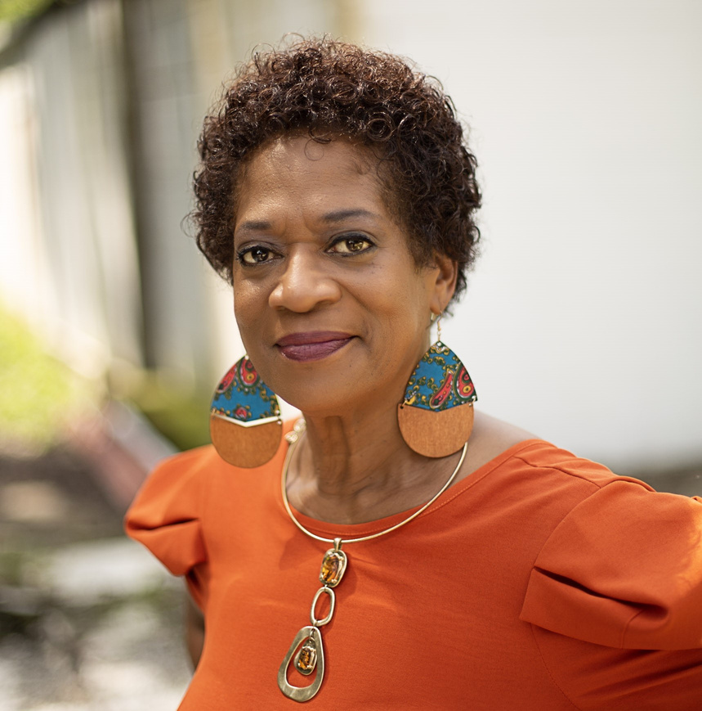
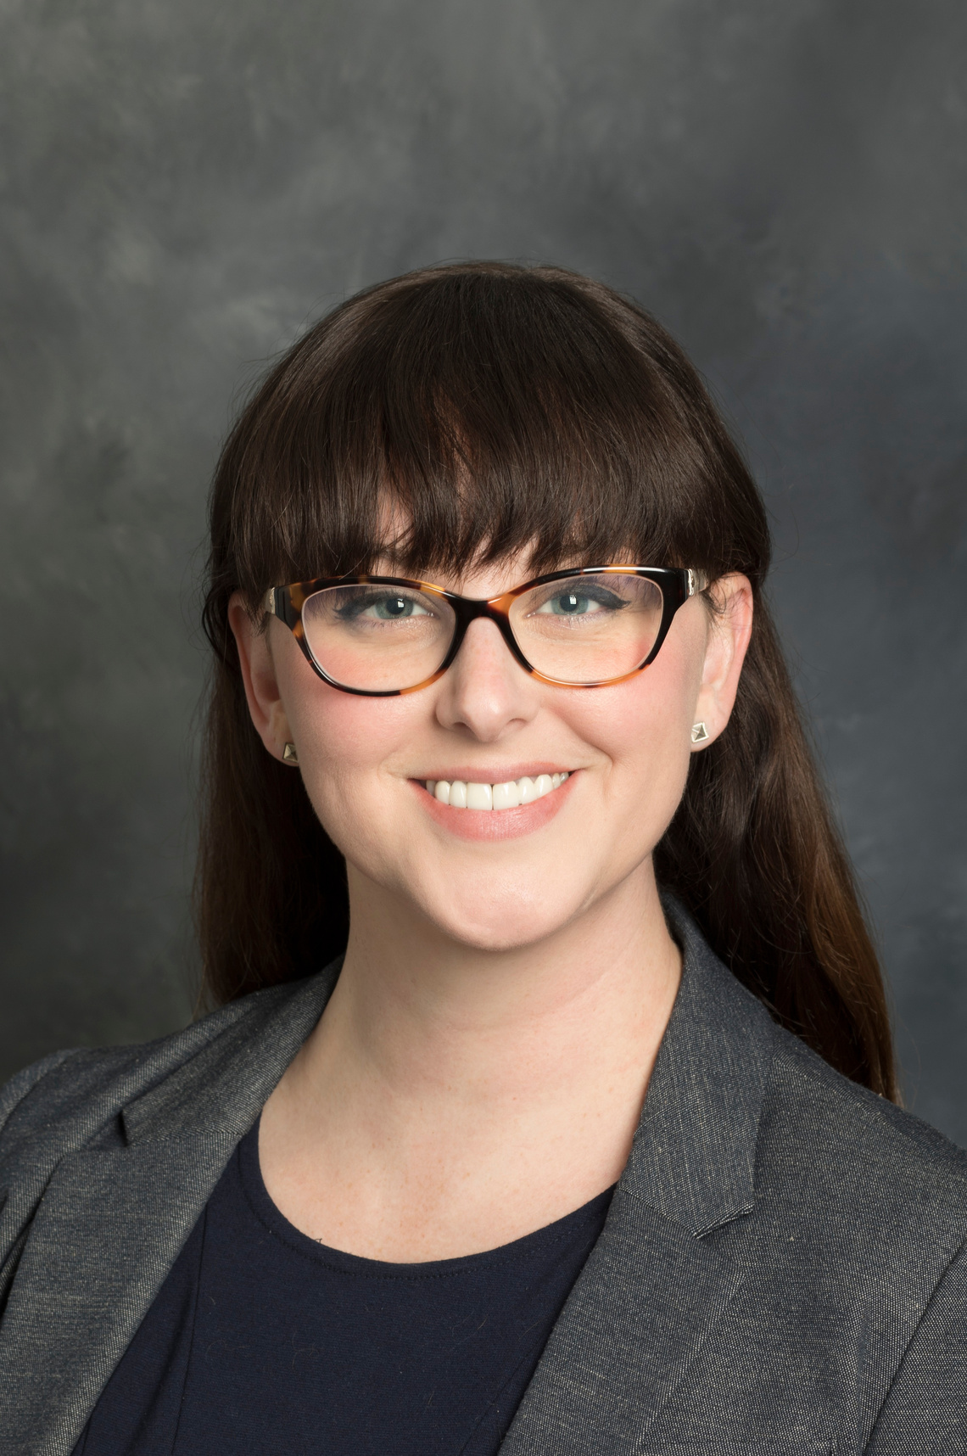
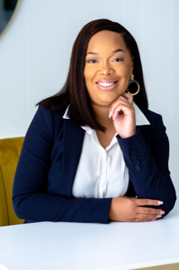
Tiffany Mack, MPH, MCHES
401 Consulting
Rana Peri Davis
Katie Zenger, MPH
Zenger Strategies

Slide 4
HOUSEKEEPING
Phones = Silent
Restrooms as needed
Lunch + Breaks + Snacks
Workbooks/Folders
Gratitude Table

Slide 5
LUNCH!

Slide 6
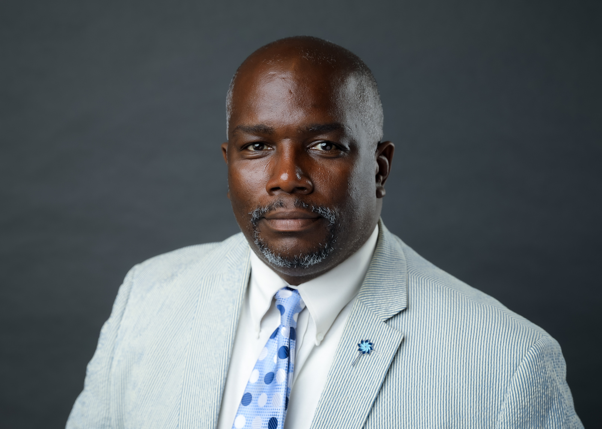
MR. ALEXIS D. PIPKINS, SR.
EXECUTIVE DIRECTOR, LEE COUNTY FIRST STEPS

Slide 7
CELEBRATE/
CELEBRATION!

Slide 8
TRUST

Slide 9
BUILD/
BUILDING

Slide 10
RELATIONSHIP

Slide 11
WORK

Slide 12
COMMUNITY

Slide 13
TOGETHER

Slide 14
PUSH

Slide 15
EXERCISE

Slide 16
TIME

Slide 17
FORWARD

Slide 18
MOTIVATION

Slide 19
LONELY

Slide 20
FOOD

Slide 21
PEACE

Slide 22
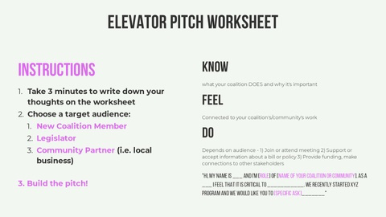

Slide 23
What do you want to KEEP doing in 2024? What have you been doing in terms of building inclusive and resilient communities that works well AND/OR you have the resources to continue?
KEEP
What you want to STOP doing in 2024? What programs or policies are no longer relevant or useful?
STOP
What do you want to START doing in 2024? What new programs, policies, procedures, grants or opportunities are available and useful for your community?
START
Notes:
What do you want to KEEP doing in 2024? What have you been doing in terms of building inclusive and resilient communities that works well AND/OR you have the resources to continue?
What you want to STOP doing in 2024? What programs or policies are no longer relevant or useful?
What do you want to START doing in 2024? What new programs, policies, procedures, grants or opportunities are available and useful for your community?

Slide 24
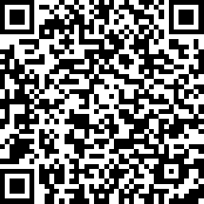
THANK YOU ALL SO MUCH!

