Slide 1


Slide 2


Slide 3
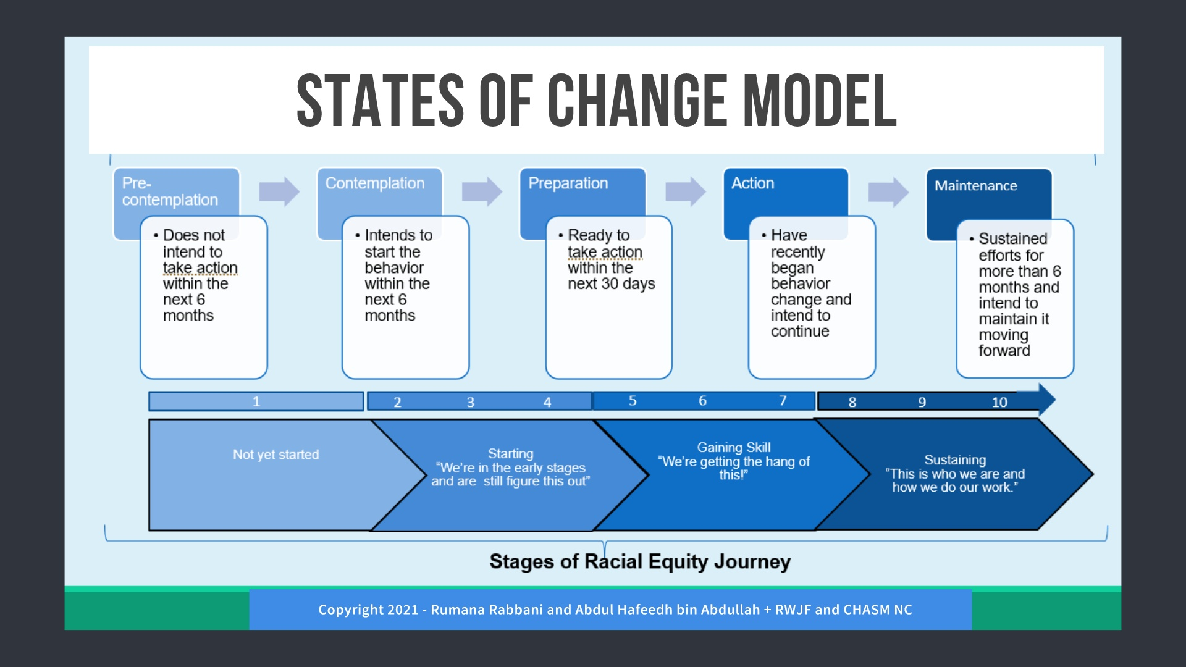

Slide 4
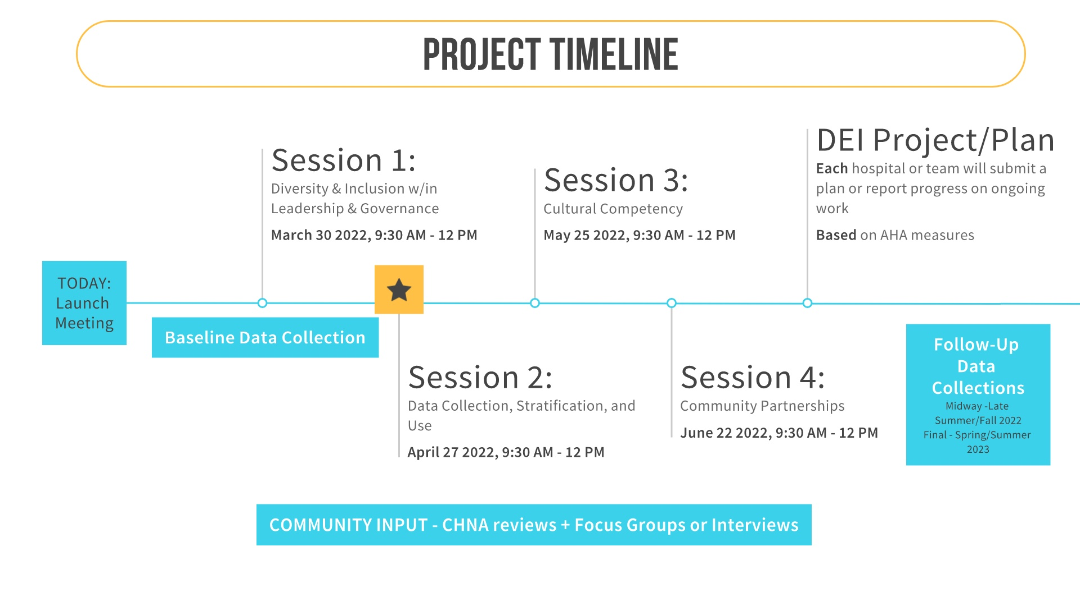

Slide 5


Slide 6
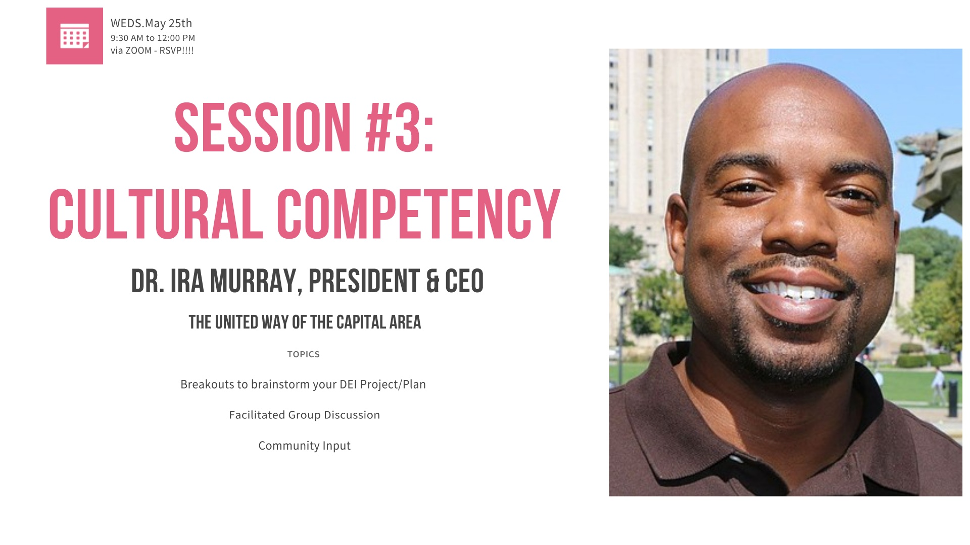

Slide 7
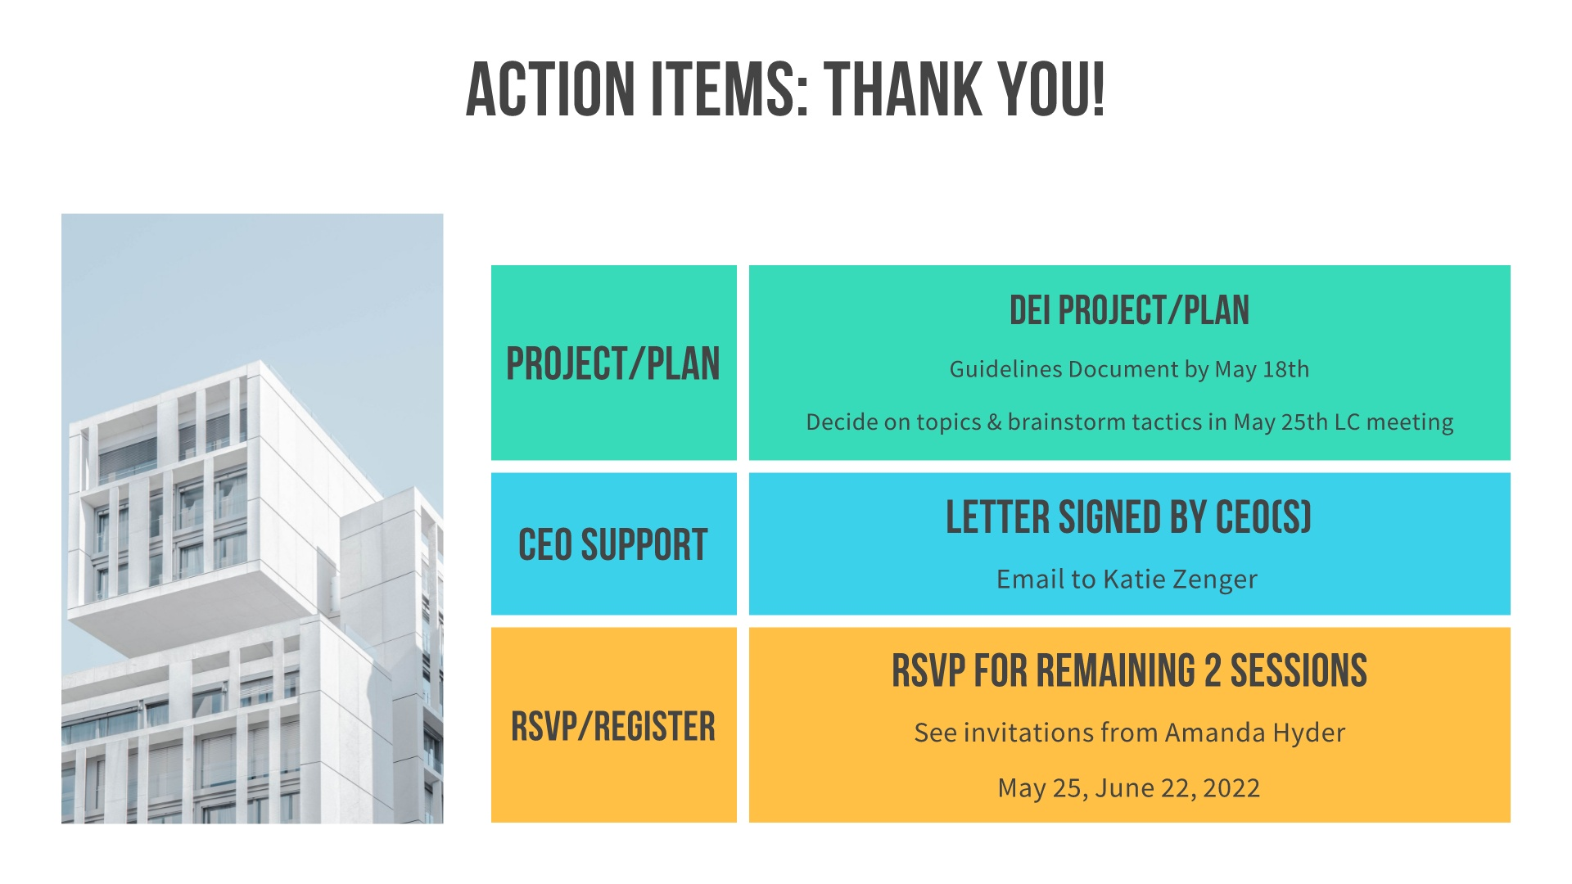

Slide 8
Baseline Data
Collection Overview
Aunyika Moonan, PhD, CPHQ

Slide 9
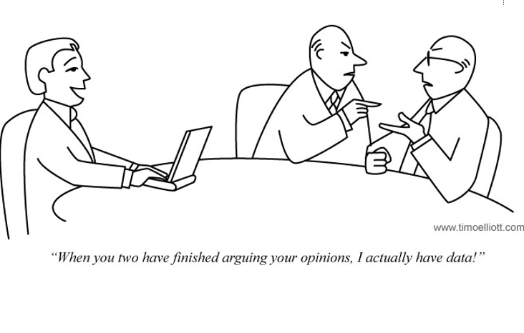
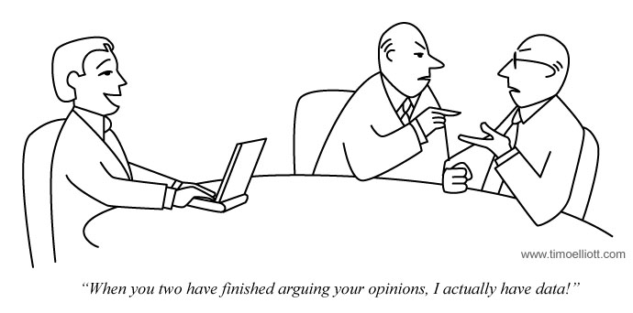
2

Slide 10
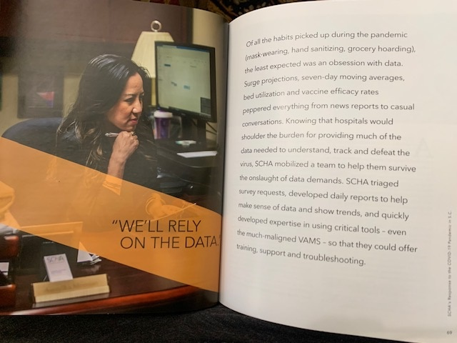

Quoted in SCHA’s Response to the COVID-19 Pandemic in SC
Things get done only if the data we gather can inform and inspire those in a position to make a difference.
-Mike Schmoke, thought leader and author
3

Slide 11
What is our current DEI landscape and what areas need help?
4

Slide 12

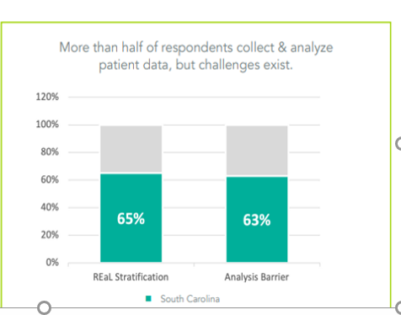
5

Slide 13

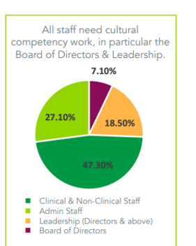
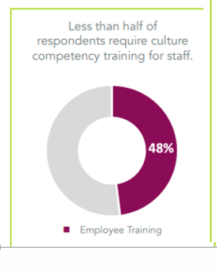
6

Slide 14
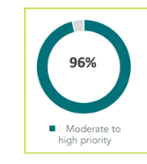

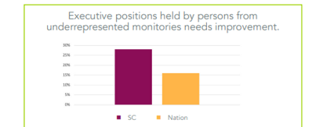
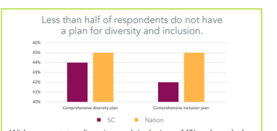
minorities
7

Slide 15

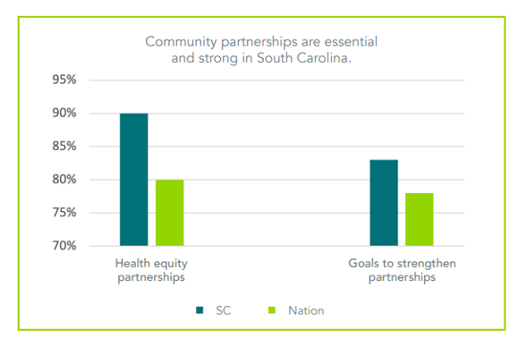
8

Slide 16

Data insights
9

Slide 17

Data Insights
Data ranges for all measures
% were low or NA
Data specific to hospitals if possible
Notes provided
All submitting hospitals had measures not collecting or needs improvement
Community partnerships aligned
We are on this EDI journey together
10

Slide 18
Better:
  Percent of community partners aligned with priorities
  Percent of patient records with collection of REaL data fields during registration or beyond.
Needs improvement:
  Percent of diverse employees who participate in employee resource groups. LEADERSHIP
  Percent of opportunities in which DEI data are used to drive strategic decisions with governance committee. LEADERSHIP
  Percent of patient records with social needs data DATA Rate of patient satisfaction scores stratified by race pre- and post cc training CULTURAL COMP
  Rate of patient satisfaction scores stratified by race pre- and post implicit bias training. CULTURAL COMP
11

Slide 19
Contact Information
Aunyika Moonan, PhD, CPHQ
Executive Director,
Data and Measurement, SCHA
amoonan@scha.org
803-744-3534
12

