Slide 1
Amanda R. Morgan, MPA
Director, Community Health, Wellness, & Outreach

Slide 2
Diversity & Inclusion Initiative
Phase 1 | Engage Senior Leadership. Create Diversity, Equity, and Inclusion Team.
Phase 2 | Develop Leadership Training that would impact and educate across the organization.
Phase 3 | Implement Personality Assessment “True Colors” Implement Poverty Simulation Exercise
Phase 4 | On-Going strategic organizational planning that includes a Data Dashboard for Community Health, Wellness, and Outreach Department.

Slide 3
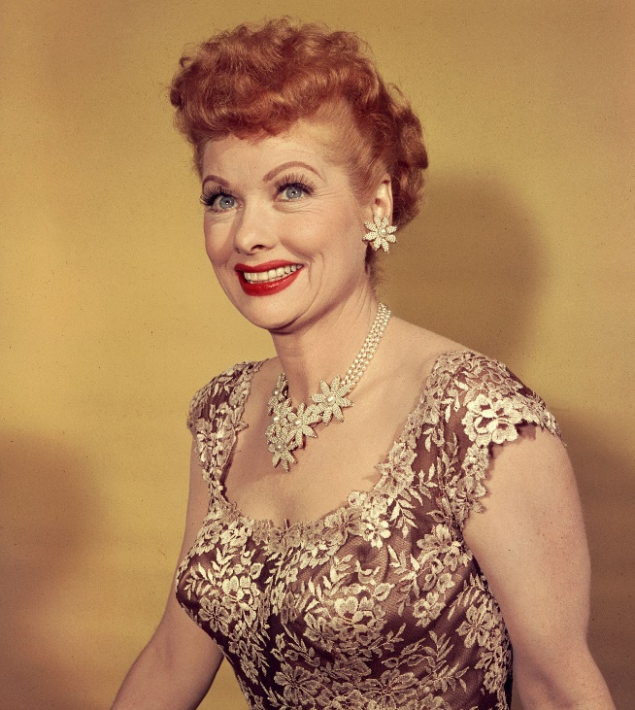
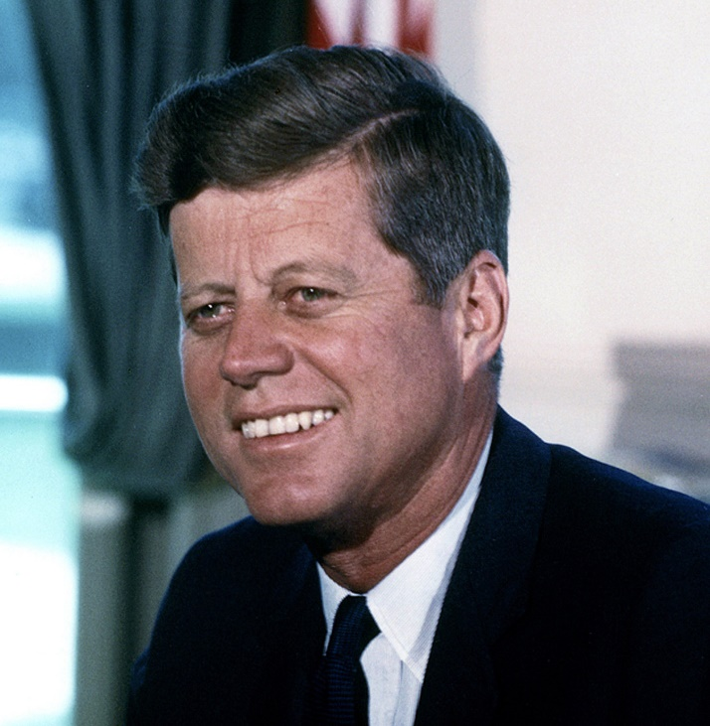
True Colors Personality Assessment
Orange
Energetic, Spontaneous, Charming

Slide 4
True Colors Personality Assessment
Gold
Punctual, Organized, Precise

Slide 5
True Colors Personality Assessment
Green
Analytical, Intuitive, Visionary

Slide 6
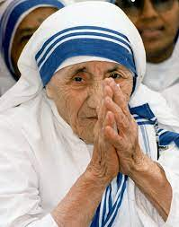
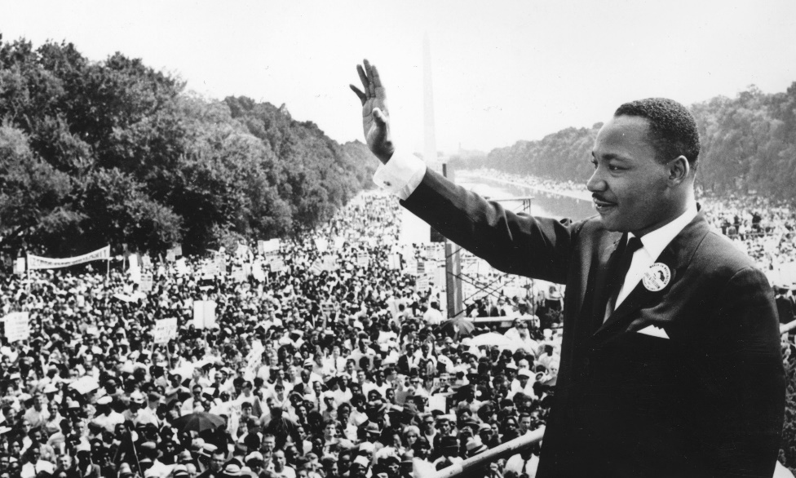
True Colors Personality Assessment
Blue
Empathetic, Compassionate, & Cooperative

Slide 7
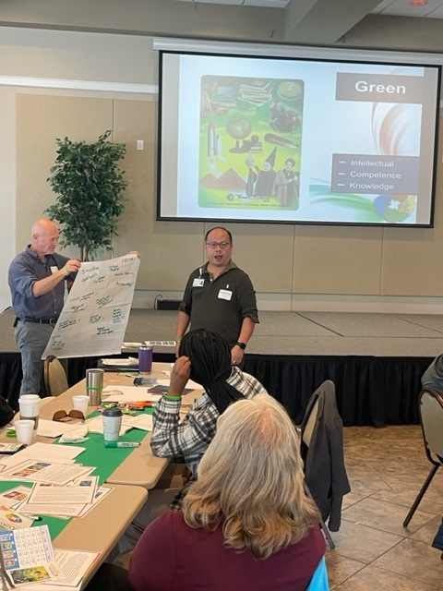
Collaboration
Walking through each personality trait allowed the leadership team to gain perspective on the strengths and weaknesses of each other, and how to work together complete a task.

Slide 8
Community Action Poverty Simulation
Human behavior is shaped by environment and experience. The Community Action Poverty Simulation (CAPS) is an interactive, immersive experience that gives participants a glimpse into the barriers facing individuals living on low-income. From single parents caring for their children to senior citizens maintaining self-sufficiency, the simulation sensitizes participants to the realities of poverty and aims to bridge the gap from perception to understanding.

Slide 9
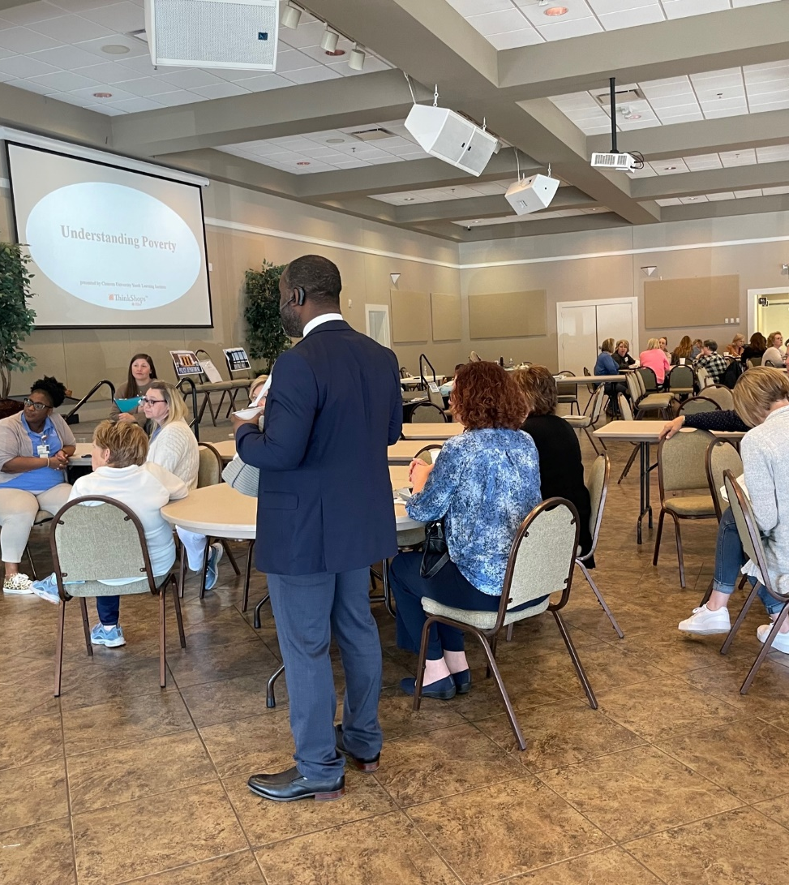
Outcomes
Relationship building.
Learn about realities of poverty.
Gain empathy, compassion, and respect.

Slide 10
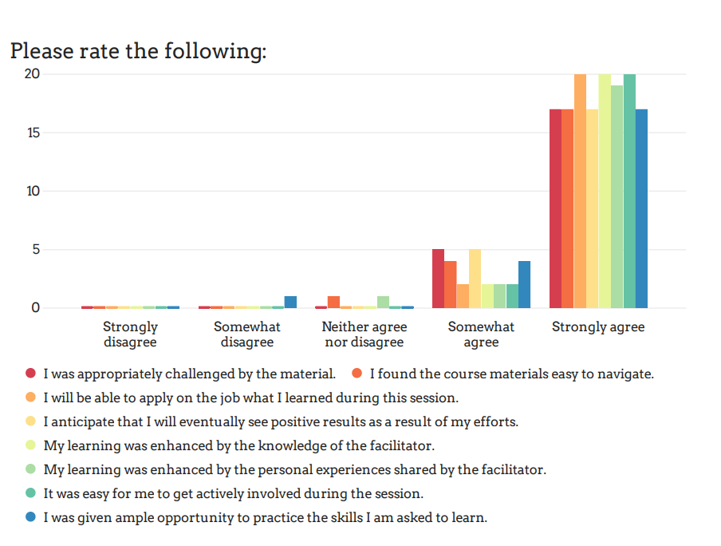
Community Action Poverty Simulation

Slide 11
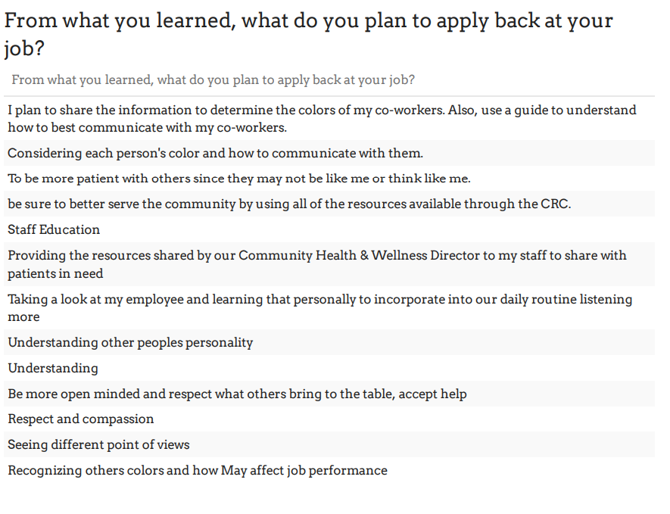

Slide 12
Questions

