Slide 9
Notes:
Turn it over to USC/Introduce Jennifer and Latesha - Antonio will introduce Seek - first to understand Find - Common ground Walk - a mile in another's shoes Learn - Learn to Listen and pause before speaking Express - Express what you are really feeling

Slide 15
Notes:
10 minutes – 3 people per groupBreakout – pre-assignedMixture – geographic region together – do not want 2 people from the same coalition to be in the same breakout groupSharing experiences across organizations/coalitions3 minute warning 1) 2) What are some physical examples of structural racism in your community? – how do you see it in Greenville, how do you see it in Florence?

Slide 19
Notes:
Necessite - https://necessite.co/shop/the-shop/
The Nile List - https://www.thenilelist.com/

Slide 20
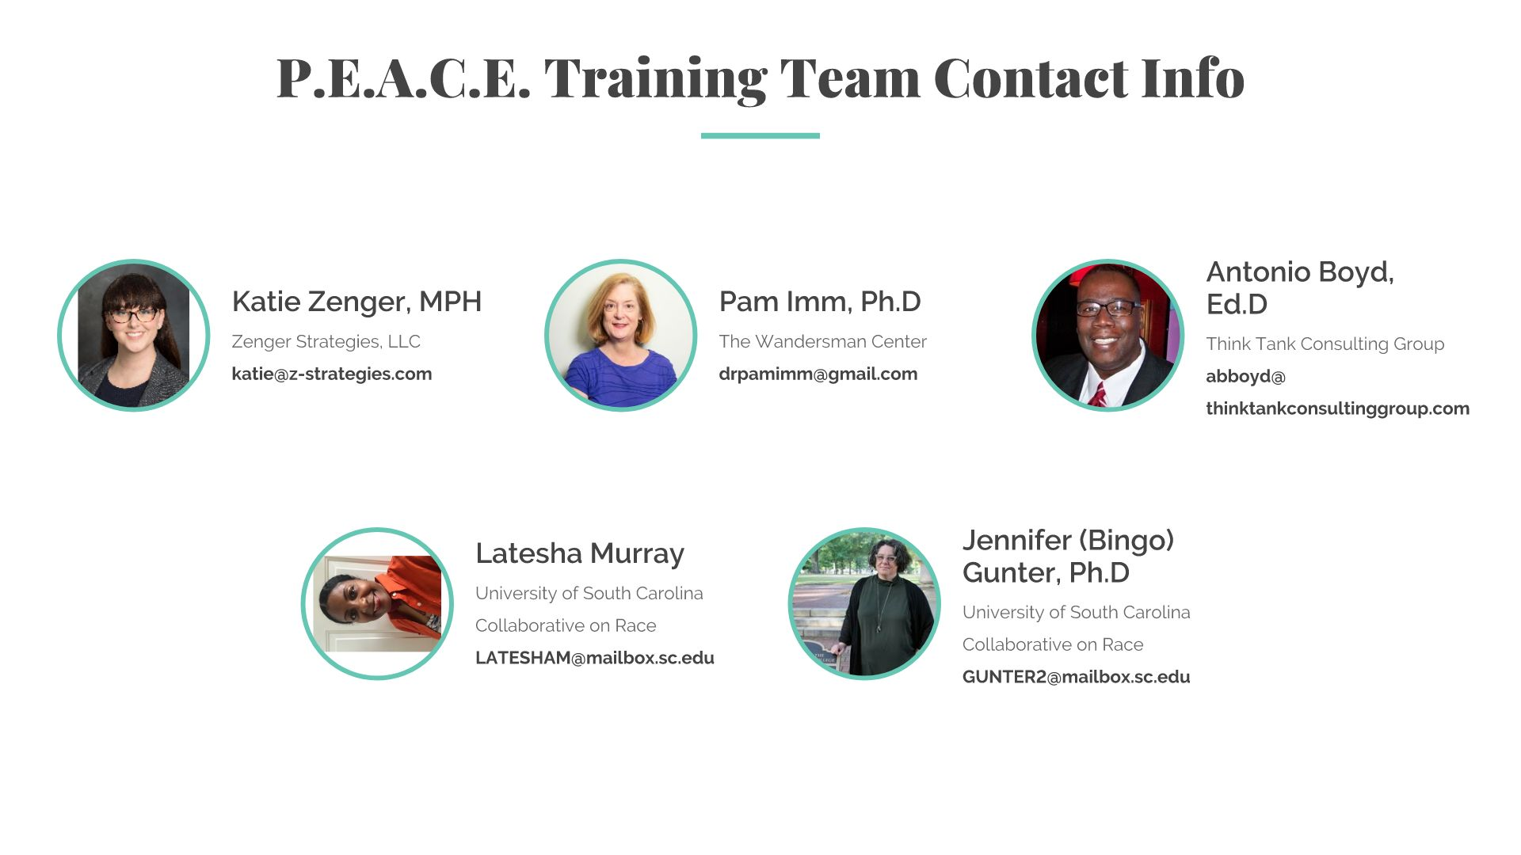

Slide 25
Notes:
Everyone come off mute and say thank you!

