Slide 1
What Data Tells Us: Do You Matter?
Leon D. Caldwell, Ph.D.
Senior Director, Health Equity Strategies and Innovation
Institute for Diversity and Health Equity
American Hospital Association

Slide 2
Introduction
Two Lies and a Truth
There is no safety plan without an equity plan.
Because of HIPPA we cannot collect good demographic data on our patients.
REaL data should not inform our care because we give all our patients the same care.

Slide 3
Exercise: Tell me about you
Does your data matter?
Collecting valid stratified data is not a performance it is a tool for better treatment outcomes, retention of workforce and cost savings.

Slide 4
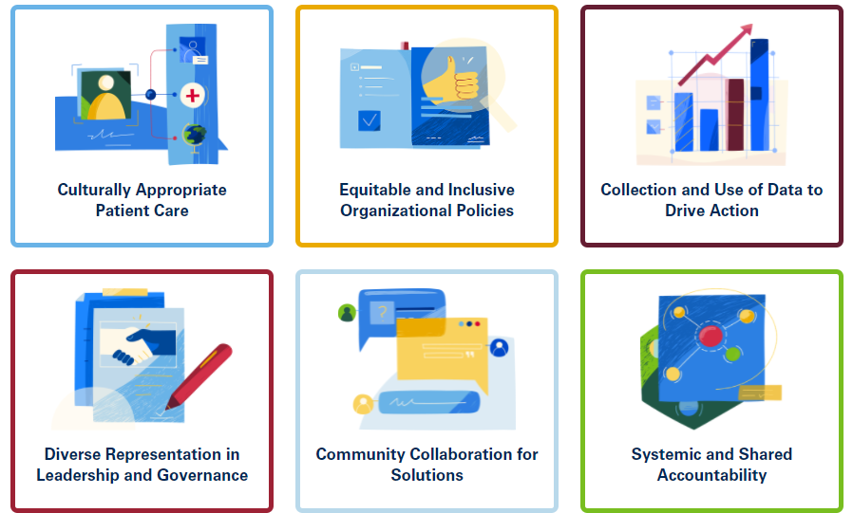
AHA Health Equity Roadmap
The Six Levers of Transformation
Research and experience show that leading health equity strategies cut across six levers of transformation within health care organizational structures.
The Health Equity Roadmap is a framework to help hospitals and health care systems chart their own paths toward transformation — thus becoming more equitable and inclusive organizations.
Notes:
Why these Six Levers? Discuss that they come from the 123 for Equity Pledge. Give more history about AHA’s work in this area.

Slide 6
Collect the Data using a uniform framework

Slide 7
Data Validation

Slide 8
Data Stratification

Slide 10
Case Studies

Slide 11
Case Studies

Slide 12
Breakout Exercise
What?
So What?
Now What?

Slide 13
Breakout Exercise
What?
Health Disparities Data
Notes:
Source: https://datacenter.kidscount.org/data/customreports/6310/any

Slide 14
Breakout Exercise
2. So What?
What data do we need to look at in our hospital? (REaL)
What is a good upstream indicator/how can we improve access to care for this population? (emergency room visits)
3) Meaning/Takeaways?
Increase access to…?
(Sutter: Asthma prevention community program w/ FQHC)
Notes:
Source: https://datacenter.kidscount.org/data/customreports/6310/any

Slide 15
Breakout Exercise
3. Now What?
IN YOUR GROUPS:
Introductions + Reporter
ID & Discuss a disparity you’re aware of at your hospital (i.e. Infant mortality, heart disease, overdose deaths) – choose one
What policies can you change or implement to begin to address this issue?

Slide 17
Breakout Exercise
What?
Health disparities data: Infant Mortality rates in SC
South Carolina 2019
Black- 27.1%
White- 64.5%
Hispanic- 6%
The infant mortality rate (IMR) was lowest among births to non-Hispanic White women (4.5 infant deaths per 1,000 live births)
The IMR was more than twice as high among live births to non-Hispanic Black women (2.4 disparity ratio; 10.8 infant deaths per 1,000 live births), 20% higher among births to Hispanic women (1.2 disparity ratio; 5.2 infant deaths per 1,000 live births), and 40% higher among births to non-Hispanic women of other races (1.4 disparity ratio; 6.3 infant deaths per 1,000 live births).
Notes:
Source: https://scdhec.gov/news-releases/south-carolinas-infant-mortality-rate-decreases-remains-above-national-average

