Slide 1
Keeping it REaL:
One Journey to Capture REaL Data and a
Foundation for Transformation
Suzanne Wilson, RN, MBA
AVP, Population Health
Rural Hospital DEI Learning Collaborative
April 27, 2022

Slide 2


AnMed Health Quick Facts
588 Bed Acute Care System
Level II Trauma Center
Emergency Department visits: 45,000
Admissions: 23,000
Active Medical Staff: 575
Employees: 3,500
Largest employer in Anderson County
Source : CY2021
Notes:
JS
461 AnMed Health Medical Center
72 AnMed Health Women’s and Children's Hospital
55 AnMed Health Rehabilitation Hospital
Located in the Upstate of
South Carolina

Slide 3








Pursuit of Excellence
AnMed Health has earned numerous awards and accreditations for quality care, including recognitions from HealthGrades, Leapfrog, and SC Hospital Association.
Notes:
JS
Mission - to passionately blend the art of caring with the science of medicine to optimize the health of our patients, staff and community.
Vision - to be recognized and celebrated as the gold standard for healthcare quality and community health improvement.
Member of the AHA Institute for Diversity and Health Equity

Slide 4

“Gracious Space”
“…kindness, mercy, tact, compassion, a desire to understand – a generosity of spirit…that moves us into more meaningful, productive, nourishing and just relationships.”
– Patricia M. Hughes
The Center for Ethical Leadership
Honest
Safe
Attentive (Listening)
Engaged
Respectful

Slide 5

Effective Diversity Management (2001)
‘Differentiology’ (2007)
Cultural Competence (2011)
Elimination of Health Disparities (The Next Decade)
Notes:
5
Differentiology is a guiding principle from a former CEO to understand our differences .. Races, religions, ethnicities, and lifestyles

Slide 6
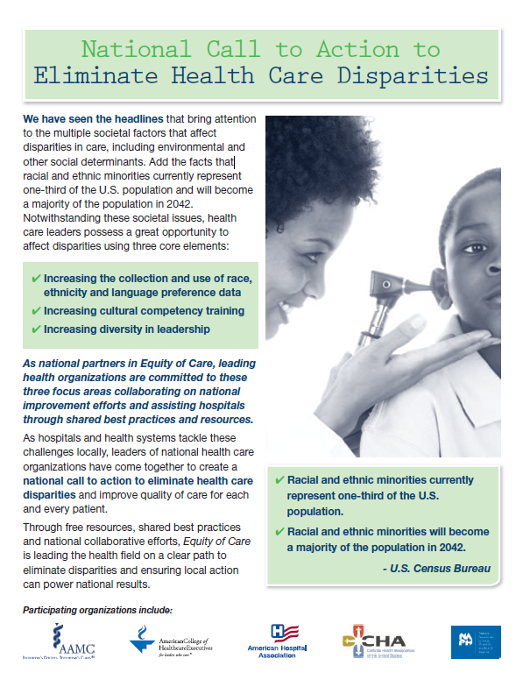
Call to Action !
“Addressing disparities is no longer just about morality, ethics and social justice: It is essential for performance excellence and improved community health.”
Association of American Medical Colleges
American College of Healthcare Executives
American Hospital Association
Catholic Health Association of the United States
National Association of Public Hospitals and Health Systems
Notes:
Over a decade ago … we believe essential for performance excellence and improved community health

Slide 7




AnMed Health’s Equity of Care Pledge
GOAL I Collection, Stratification & Use of Data | Race, Ethnicity and Language Data Collection Sexual and Gender Minority Patient Data Collection
GOAL II Cultural Competency Training | Physicians - Physicians Network Services Nursing Services – RNs Other Clinical Professionals Non-Clinical, Patient-Facing Teammates
GOAL III Diversity in Leadership & Governance | Health Equity Assessment Health Equity Transformation Board of Trustees
GOAL IV Community Partnerships | Safety Net Council Alliance for a Healthier South Carolina
Notes:
AHA #123 For Equity Pledge to Act to Eliminate Health Care Disparities

Slide 8

A Beginning ….
Notes:
OMB .. Alignment for racial and ethnicity categories 1997. Nationally we have a standard language to describe ..

Slide 9

Our Project
Disparities Leadership Program 2011-2012
AnMed Health: Disparities Dashboard
Abstract
The goal of our project was to research and develop a disparities dashboard to identify and strategically address AnMed Health’s most vulnerable, underserved and costly patient populations. The disparities dashboard is adjunct to our system-wide quality measures and management strategies.
Notes:
JS

Slide 10
Phase I Objectives
Establish dashboard research and implementation team
Matthew Cline, MD; Barrett Ludley, MBA
Establish dashboard framework
Identify priority populations
Project Evaluation
Phase I Completion
Project concluded with formal presentation February 9, 2012. Recipient of one of
two awards of excellence issued by Joseph Betancourt, MD, Director of the
Disparities Solution Center, Massachusetts General Hospital
Phase II – Transition to Intervention
Continuation of Phase I
Geo-coding
Refine demographic data collection
Notes:
10

Slide 11
Dashboard Components
Quality & Disparities
Quality
Appropriate Care Scores
  Heart Failure; AMI; Pneumonia; SCIP; + VTE/IMM
  + Stroke
Patient Satisfaction
  H-CAHPS
Readmissions
  + COPD
Disparities
Diversity Snapshot
  Service Volumes
  Business Line Analysis
Language Services
Circa: 2013
Notes:
SW

Slide 13
Diversity Snapshot

Slide 14
Appropriate Care Score Populations:
Heart Failure (HF)
Acute Myocardial Infarction (AMI)
Pneumonia (CAP)
Surgical Care (SCIP)
Stroke
VTE prophylaxis
Immunizations
New measures added in 2014
New measures
Notes:
Speak to readmissions

Slide 15
Appropriate Care Scores

Slide 16
COPD readmission rates added in Q3 2013

Slide 17

Fundamentals
Leadership support
Organizational effort
Education
‘Why’
Pursuit of accurate REaL data

Slide 18
Best Practices for Collection
Effectiveness starts internally
  Scripting and the ‘why’ with staff
    Better care, better outcome, better experience
  Education and EMR
    Accurate capture becomes data
    Completeness
    Limit ‘unknown’ responses
  Organizational Effort
    Track and trend
Notes:
Registration areas are ‘key’ – standardization

Slide 19
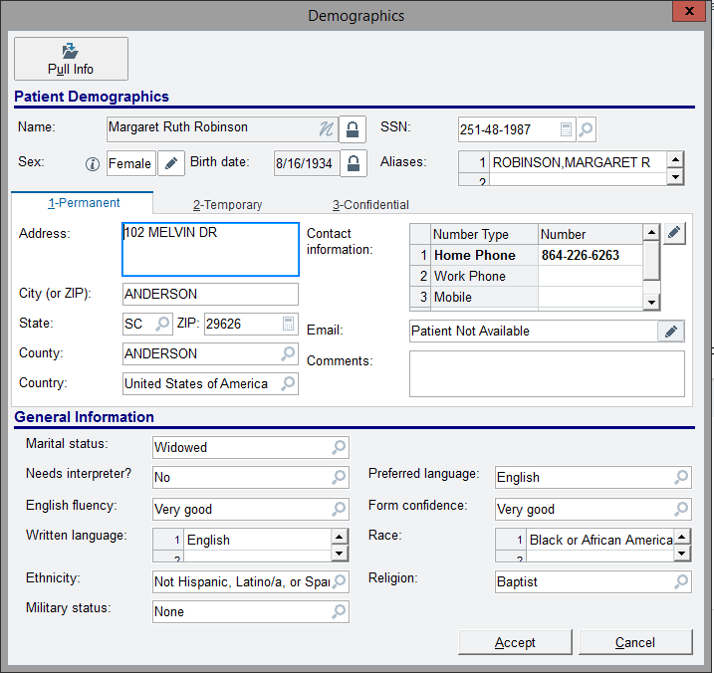
Demographic Matrix
Question/Answer/Clarification: Accurate, Complete, Unique, Timely and Consistent
Gender
Question: What was your gender at birth?
Patient Response: What can’t you tell!
Clarification: We want to make sure that treat everyone fairly and give them a chance to answer for themselves
2. What name do you prefer?
3. Race
Question: What is your race?
Patient Response: None of your business! Why do you have to know that?
Clarification: We want to make sure that all the information we have about you is accurate and complete
Percentage of unknown respondents should be very low. Data needs to be accurate!
4. Ethnicity
Question: Where were you born?
Patient Response: Why do you need to know?
Clarification: We want to provide you with the best most appropriate care.

Slide 20
Data Stratification and Projects
Assemble a working group focused on disparities
  Multidisciplinary approach
  Consider stakeholders in collection and populations
  Incorporate current work when possible
Validate the REaL data
Identify highest priorities for stratification
  Understand your community
Determine if stratification possible on selected metrics
Stratify
Source: AHA ‘A Framework for Stratifying Race, Ethnicity, and Language Data 2014
Notes:
Dashboard

Slide 21
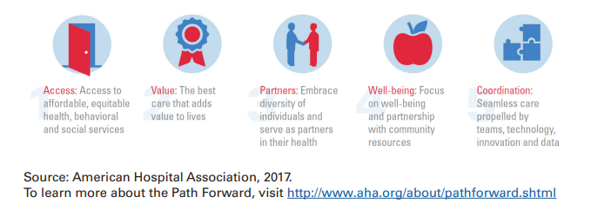
Population Health View
Notes:
Leverage high powered EMRs – ‘SDOH’ wheel, real time alerts, work flows, disease registries

Slide 22

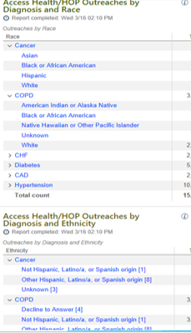
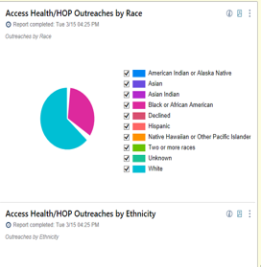
Access Health Epic Dashboard Tools

Slide 23

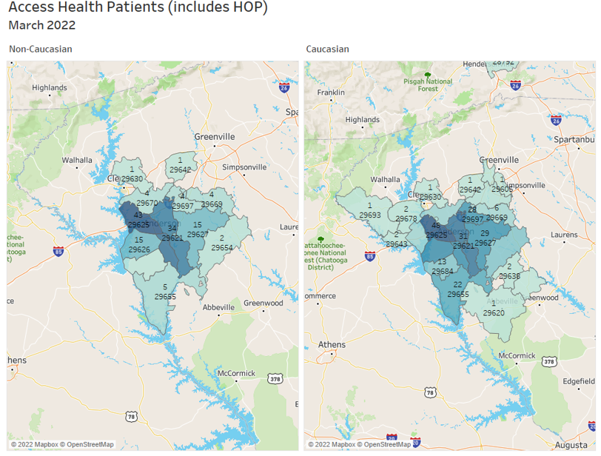
Visual Mapping – Interactive Maps

Slide 24

Emerging Efforts – Where are we now?
  Access Health of Anderson
    Diabetes Management
  Value Based Care
    Chronic Disease Management
      2 or more diseases and 4 or more medications
    Annual wellness screenings
      Colorectal Cancer Screenings and Mammography
  Social Determinants
    SCHA SDOH Collaborative
    Focus/elevation on system wide collection

Slide 25
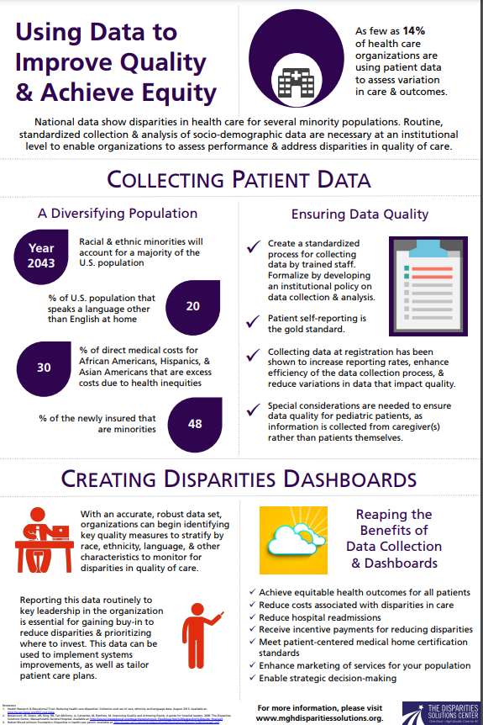
Population and
Community Health
What are you working on?
  Organizational Level
  Service Line or Department
Intersect with Community Health Needs
  CHNA
Quality Metrics
  Ambulatory/Medical Group
  Inpatient
    Readmissions
Pro TIP : Integrate with current work

Slide 26


Present and Future
“Health Equity is no longer just an imperative but an expectation.”
Notes:
Published April 2022

Slide 27
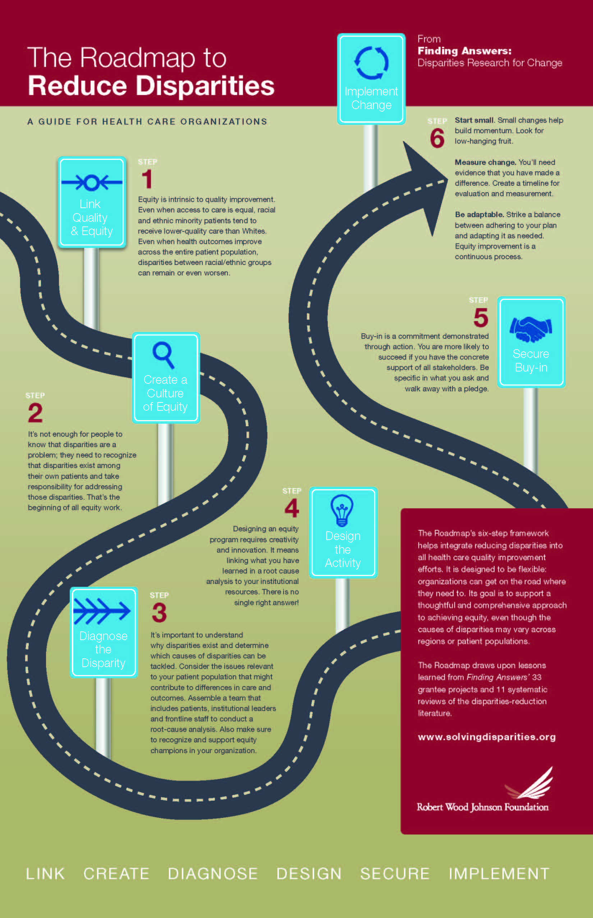
A Roadmap
1. Link quality and equity
2. Create a culture of equity
3. Diagnose the disparity
4. Design the activity
5. Secure buy-in
6. Implement change
Source: Robert Wood Johnson Foundation
Notes:
JS
Rapid PDSA Cycle

Slide 28

Questions ?

Slide 29
Contact Information
Juana Slade, CDM, CCF
Director, Diversity and Language Services
juana.slade@anmedhealth.org
J. Suzanne Wilson, MBA, RN, ACM-RN
AVP, Population Health
suzanne.wilson@anmedhealth.org

