Slide 3
Notes:
Due to the ongoing disproportionate impact of COVID 19 on structurally or historically marginalized communities, many hospital and health system leaders are RENEWING THEIR COMMITMENT to promote racial justice and eliminate various forms of bias. To address health inequities and practice cultural humility, hospitals and health systems must commit to increasing diversity and inclusion in the board room.- AHA Institute for Diversity and Health Equity

Slide 4
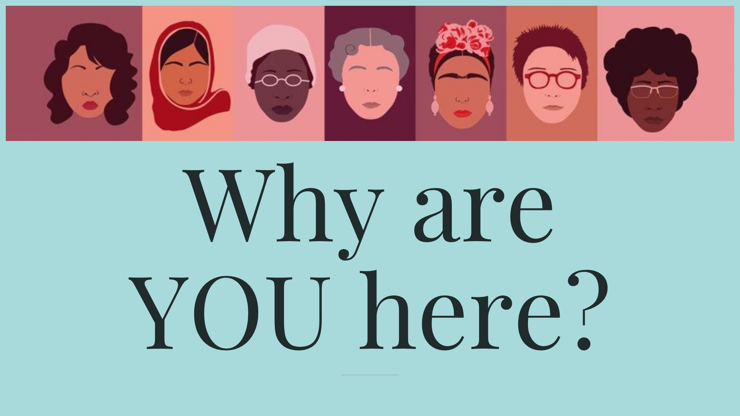
Notes:
BE VERY CLEAR. LASTING AND IMPACTFUL CHANGE STARTS AT THE TOP. You’re on the front lines giving patient care every day You can be the change makers

Slide 5
Notes:
Because our country looks like this: And our c-suites look like this: Diversity equals higher functioning teams Representation matters

Slide 6
Notes:
The staffing situation is not just limited to nurses. Since November 2021, nearly 600,000 health care and social assistance workers left their jobs, the highest on record since the Bureau of Labor Statistics (BLS) started tracking that data in 2000. According to the Bureau of Labor Statistics' Job Openings and Labor Turnover Survey (JOLTS), almost 600,000 health care and social assistance workers quit in November 2021, amounting to 3 percent of the total, and the highest number on record since the survey began in 2000. (See chart below.) Many attribute these resignations, at least in part, to health care workers' mounting emotional and physical fatigue. https://www.wcnc.com/article/news/health/carolina-counties-healthcare-nurse-shortage-health-north-carolina-regional-south-carolina-news/275-c476084d-c176-4850-a0b7-c0fdf54a87c0

Slide 7
Notes:
A study by Glassdoor concluded two-thirds (roughly 67%) of job seekers consider diversity a determining factor when considering employment AND 57% indicated that their company did not have comprehensive, thought-out D&I initiatives.

Slide 11
Notes:
August 18, 1920, the 19th Amendment to the Constitution was finally ratified, enfranchising all American women and declaring for the first time that they, like men, deserve all the rights and responsibilities of citizenship.

Slide 12
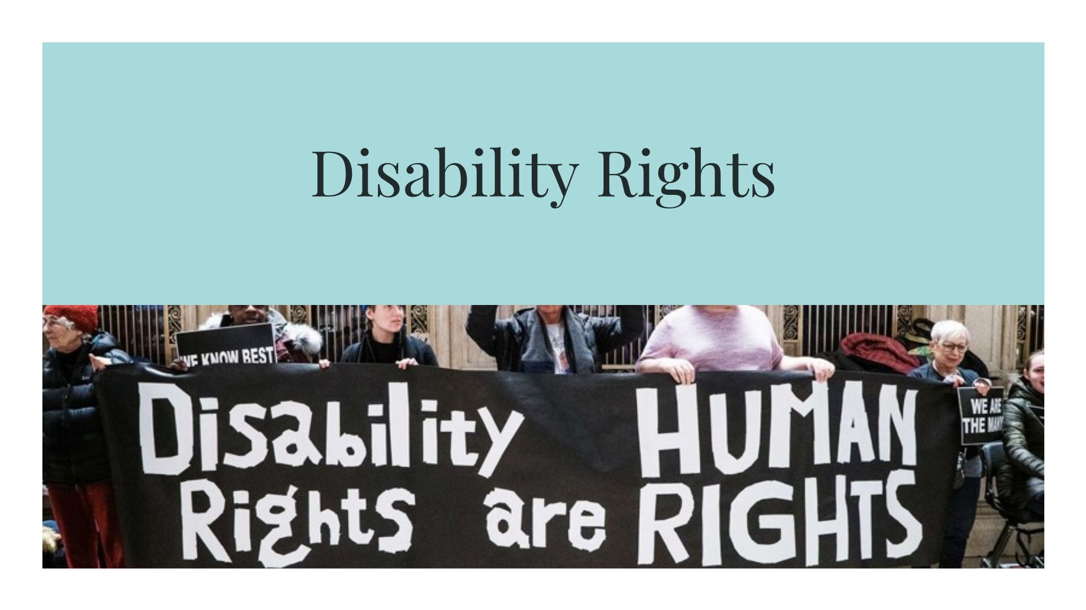
Notes:
Fair Labor Standards Act of 1938. During the hearings for the legislation, Labor Secretary Frances Perkins asked for a subminimum wage for people she called “substandard workers,” who she defined as “persons who by reason of illness or age or something else are not up to normal production.” It soon became clear that “substandard workers” and “or something else” would be interpreted in the worst possible ways. Some in Congress argued that people in the Southern United States should be paid less than minimum wage on account of being “slower.” Others argued that black workers were intrinsically “substandard,” according to a report from the Congressional Research Service.

Slide 14
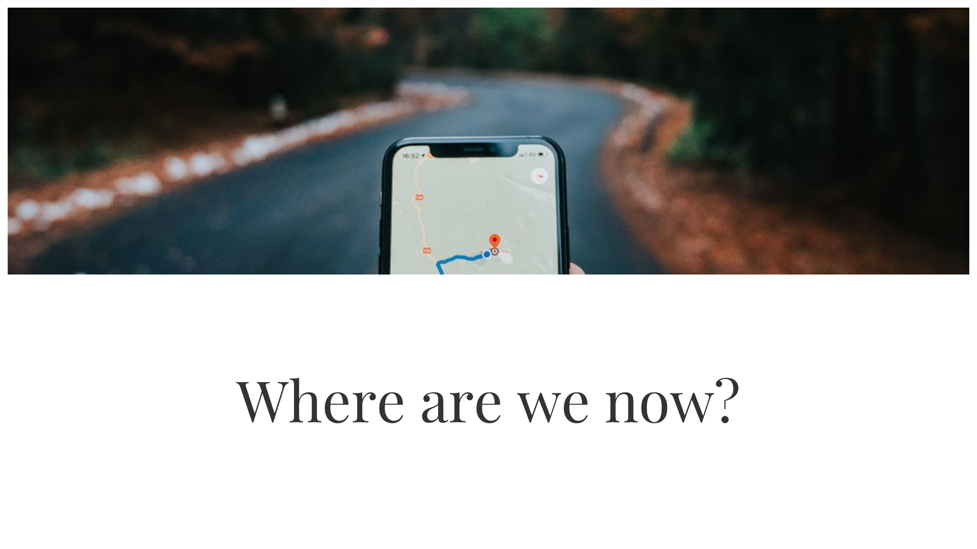

Slide 15
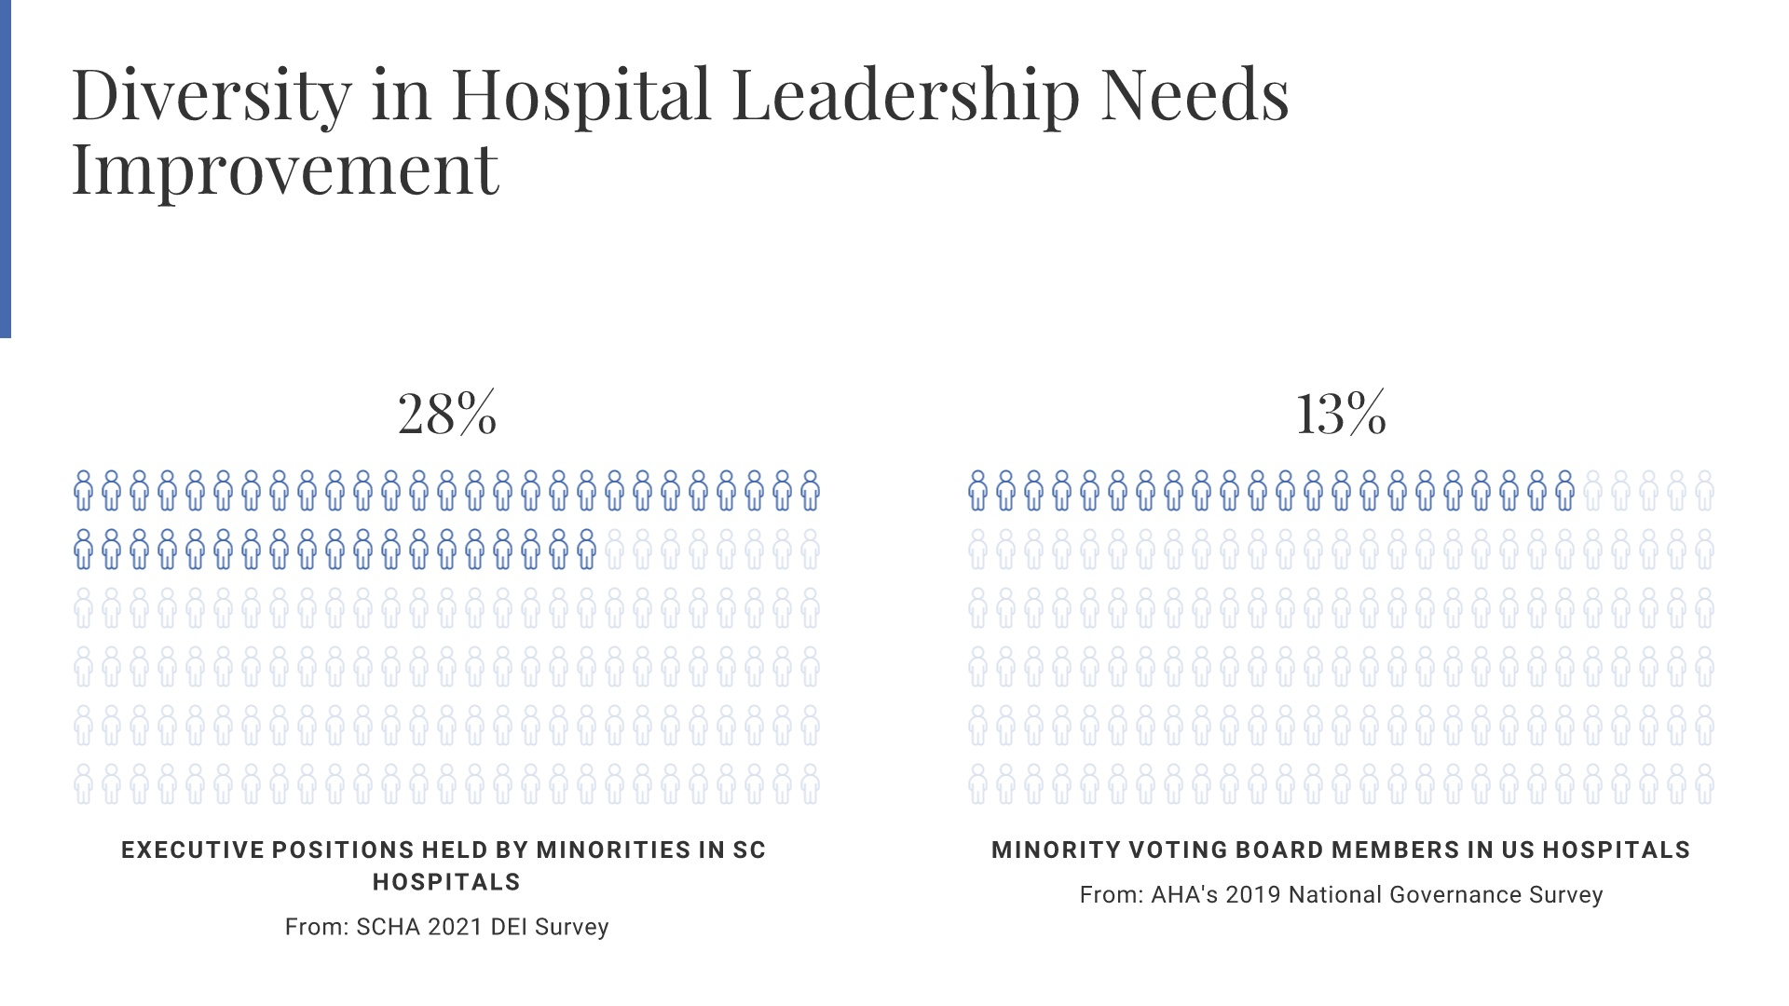
Notes:
AHA Survey Source: https://trustees.aha.org/aha-2019-national-health-care-governance-survey-report

Slide 16
Notes:
C-suites have nowhere near the representation of Black leaders compared to the percentage of minorities in the communities that they serve. And what progress has been made has been in a limited number of leadership roles. Figure 1 - while nearly half of hospitals had at least one Black leader in a C Suite role, only 10 % of total C suite positions were filled by Black leaders. Broken down further, only 18% of hospitals had at least one Black leaders filling a common C-Suite role. AND Black leaders filled only 6% of common C Suite positions in total. SOURCE: https://www.chartis.com/sites/default/files/documents/Leading%20While%20Black_The%20Chartis%20Group.pdf This report is the product of a joint initiative sponsored by the National Association of Health Services Executives (NAHSE), a non-profit association of Black healthcare executives founded to promote the advancement and development of Black healthcare leaders, and The Chartis Group, a national healthcare consulting firm committed to ensuring that antiracism beliefs and commitments are embedded in the firm’s fabric, culture, and work with our clients. Chartis analyzed the diversity of leadership teams for 100 leading hospitals in the U.S. that are organizations on the U.S. News Honor Roll, 100 Great Hospitals list, and community-based and critical access hospitals. These organizations include leading academic medical centers, members of integrated delivery networks, children’s hospitals, and safety net hospitals. The purpose of this analysis was to provide a snapshot of Black representation in C-suite positions based on publicly available information.

Slide 17
Notes:
Figure 2- This shows which C Suite roles have the greatest diversity. Top 3 executive roles for Black leaders are: 1) Diversity/Equity - 81% Black 2) Human Resources - 32% Black 3) Operations - 12% Black. ONLY 6% of CEOs are Black. Gender differences in this study: Black leaders in these roles - significant majority of DEI officers were women, and a more even split of Black men and women in the HR and OPerations roles. SOURCE: https://www.chartis.com/sites/default/files/documents/Leading%20While%20Black_The%20Chartis%20Group.pdf Report information: Chartis analyzed the diversity of leadership teams for 100 leading hospitals in the U.S. that are organizations on the U.S. News Honor Roll, 100 Great Hospitals list, and community-based and critical access hospitals. These organizations include leading academic medical centers, members of integrated delivery networks, children’s hospitals, and safety net hospitals. The purpose of this analysis was to provide a snapshot of Black representation in C-suite positions based on publicly available information.

Slide 18
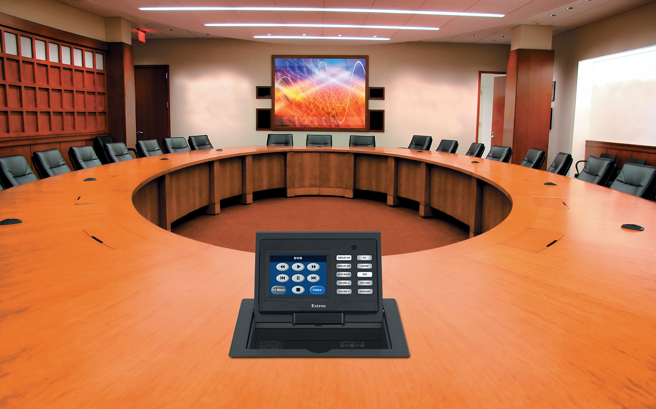
Boards are getting older
In 2005, only 9% of board members were > 70 years old
In 2018, 12% of board members were age 71 or older
Only 16% of system boards reported having any members age 50 or younger
78% of system board respondents are not undertaking specific efforts to recruit Millennials (individuals between the ages of 21 and 35) to their boards
Notes:
The clear trend is toward a growing number of older board members and fewer younger ones.

Slide 26
Notes:
Are we hiring people because we want more of the same? Are we hiring people who will add value to our organization by bringing their full lived experiences to work with them every day? Are we hiring the talent that will sustain the future of our organization? In rural areas, this is extremely important because of something called ”brain drain”. Millennials and (actually people of all working age) will crowd out cities for lesser paying jobs before they will stay in a place that does not value them.

Slide 27
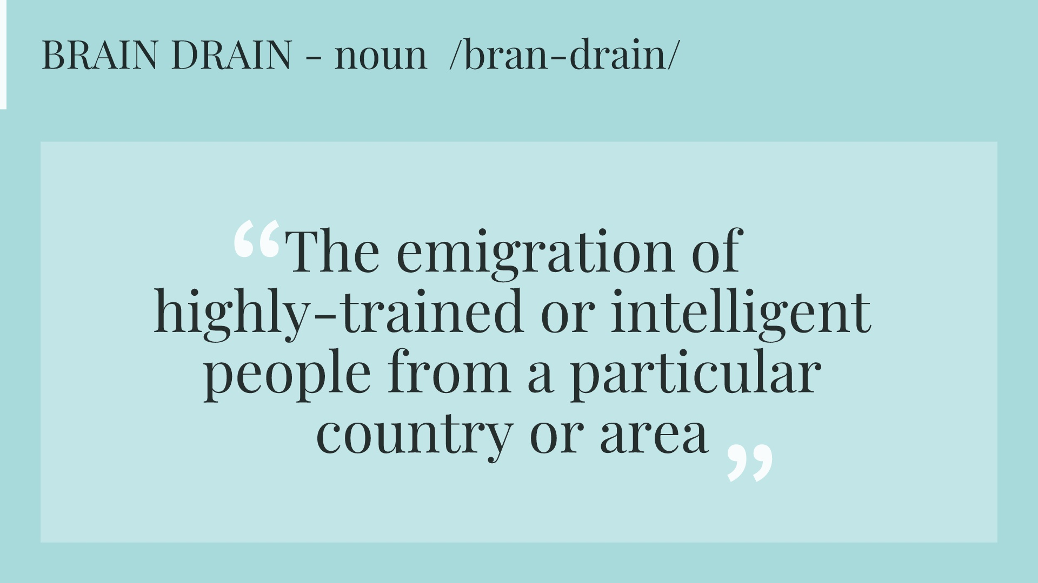

Slide 30
Notes:
Trainings Safe Space Conversations Pipelines Internships Mentorship Sponsorship

Slide 31
Notes:
Track your diversity, be transparent about your pay and what you are actually doing to work in this direction Transparency in numbers is a signal that you value those things Priortize inclusive design – websites, systems, built environment, accommodations, offering them and talking about them. Demonstrate active inclusion this way Conti Source: https://thediversitymovement.com/wp-content/uploads/2020/04/IMPACTFUL-STEPS-THE-C-SUITE-CAN-TAKE-TO-CREATE-A-MORE-DIVERSE-WORKPLACE-1.pdf nued education – ties into what works In order for a movement to be truly successful, it must be supported by the c-suite. I’m proud of our team at Walk West for initiating D&I practices in every aspect of our business. Our executive team has worked hard to develop The Diversity Movement. This movement is comprised of people from all backgrounds and life experiences who have come together for a common cause. But really, it’s more than a cause. Diversity and inclusion are a journey, a continual process unfolding into a way of living and doing business. The Diversity Movement offers courses for your business to help assess how comprehensive your D&I programs are, if any, and gives you the tools necessary to further implement these programs. Our approach to D&I builds better teams, relationships, and businesses as a whole. It’s time to make D&I more than a company culture, but a foundational mindset and way of living.

Slide 32
Notes:
Admit there is work to do, and commit to doing the work long-term Set S.M.A.R.T. goals for DEI Set consequences to foster accountability Denounce and deconstruct pillars of racism Create safe space for vulnerability Incorporate bias discussion into clinical care Provide bias training for all team members Build an equity & racial justice curriculum

Slide 34
Notes:
Companies with higher-than-average diversity show 19% higher innovation revenues - Check stat - Harvard Business Review?

Slide 35
