Slide 1
Notes:
Katie Hand off to Monique

Slide 4
Notes:
Write down on a post-it notes, one Guideposts that teaches you something about yourself or one that may challenge you

Slide 5
Notes:
Katie Hand off to Monique

Slide 6
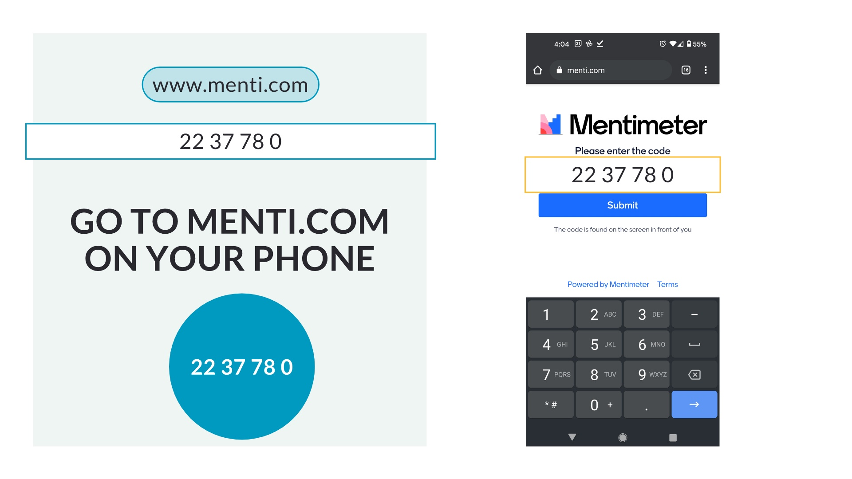

Slide 9
Notes:
Think of a “Communication Experience” that was positive, negative, or something eles What worked for you and others? What didn’t work for you and others? Delayed feedback doesn’t work well for me. When these qualities/traits are lacking – this is when ineffective rises. When these 4 work – it’s like a machine. It’s smooth.

Slide 18
Quick Breakout Group - 5 minutes
Share out
Each person take about a minute to introduce yourself, share your results and how you reacted to it.
4 to 5 ppl per group

Slide 20
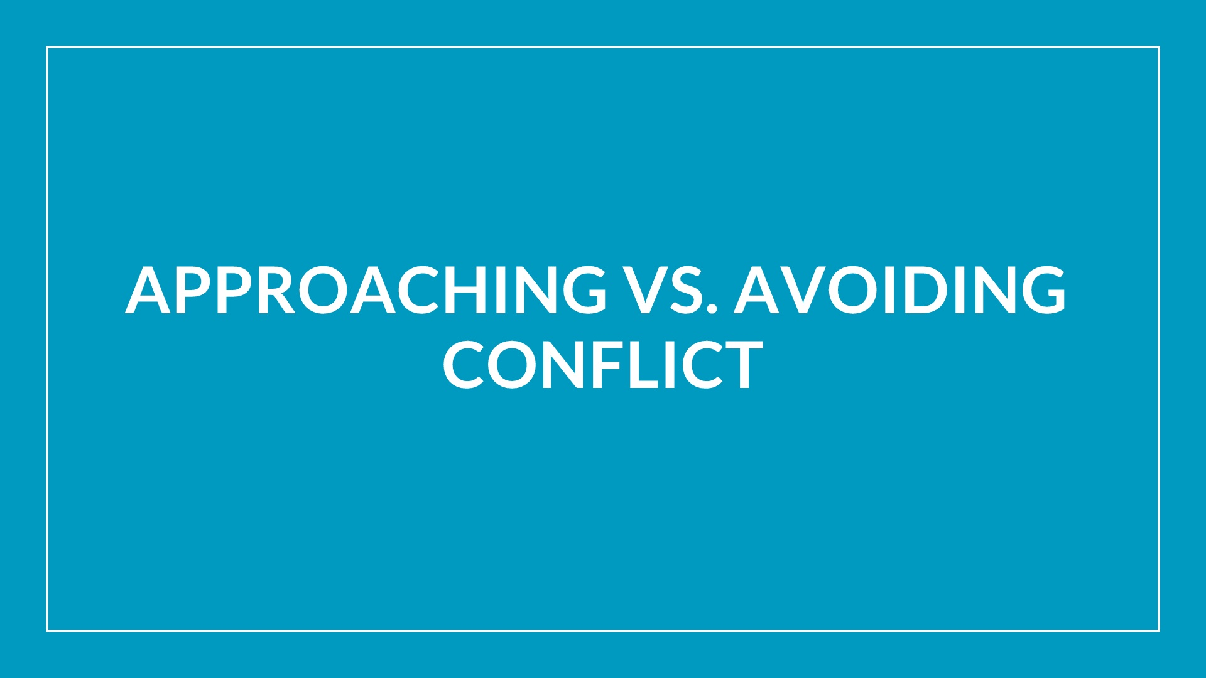

Slide 21
Notes:
Think of a “Communication Experience” that was positive, negative, or something eles What worked for you and others? What didn’t work for you and others? Delayed feedback doesn’t work well for me. When these qualities/traits are lacking – this is when ineffective rises. When these 4 work – it’s like a machine. It’s smooth.

Slide 27
Notes:
How do my habits, preferences, tendencies, and internal biases inform and shape my communication? What would you like your teammates to know about your communication style? When communicating, what can another person do that you find frustrating?

Slide 28
Questions?
LARGE GROUP: How can you practice assertiveness in professional settings? Do you think this will be hard?
Do you have any questions about differentiating between assertive and aggressive responses to conflict?

Slide 31
Notes:
“Ann, you’re late again and you’re making me late for a meeting.”REFRAME: “When people are late, I feel frustrated because work is delayed and we have to take time to tell the late person what is happening.”“You wouldn’t talk to me, you just yelled, so you didn’t get what you wanted.”REFRAME: “When I don’t know what’s wrong, I get really worried about you and I don’t know how to help.”Remember: Say what you observed, what you felt, what resulted.

Slide 32
Pair up into teams of two. Each one of you will take turns - you get 4 minutes each. Each person will recall a conflict or negative situation that you’ve experienced in the last two weeks. It can be from work or home (preferably work and preferably true).
After Partner “A” tells the story in a negative light, Partner “B” will help Partner “A” explore the silver lining and they will share the story again from a different perspective. You will switch roles. Each participant will be Partner “A” and “B”

Slide 33
Notes:
Person A: Yes, you tell them to relax and take off, but you don't model it. They see you working and stressing and they're following your lead. You send emails at 10 pm at night. I even saw one you sent at 4 am. Person B: I don't expect them to read or answer those emails. Person A: That's easy for you to say. You're the boss. And then, the first thing the next morning, if they don't have a solution or answer, you criticize them. Some people want to disconnect after work and not be re-engaged until the next day. Person B: That's just who I am and how I am. My thoughts come to me at night. I've told them they don't have to respond. Person A: Really? When you were on vacation last month - you called in every day, sent emails, and asked for updates. Person B: So, that's how I choose to spend my vacation. Why does that bother anyone else? Person A: Because you set the tone. You can tell people, "It's ok to take off. Go relax." But if you model the opposite, they're not going to trust that they can really set and enjoy their downtime. And to be honest, you're somewhat critical of people who don't work as hard you do. You may not say it with your words, but it comes across that way. Person B: I like to work. It's what I live for. Again, they don't have to be like me. I'll remind them at the next team meeting.

Slide 34
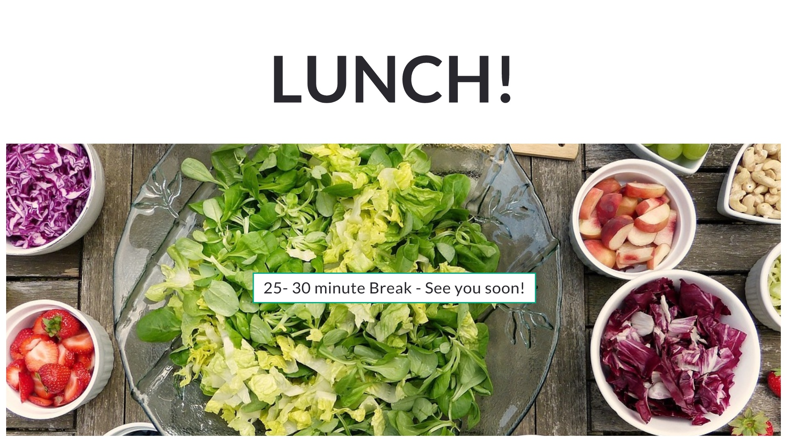

Slide 36
Notes:
How do my habits, preferences, tendencies, and internal biases inform and shape my communication? What would you like your teammates to know about your communication style? When communicating, what can another person do that you find frustrating?

Slide 37
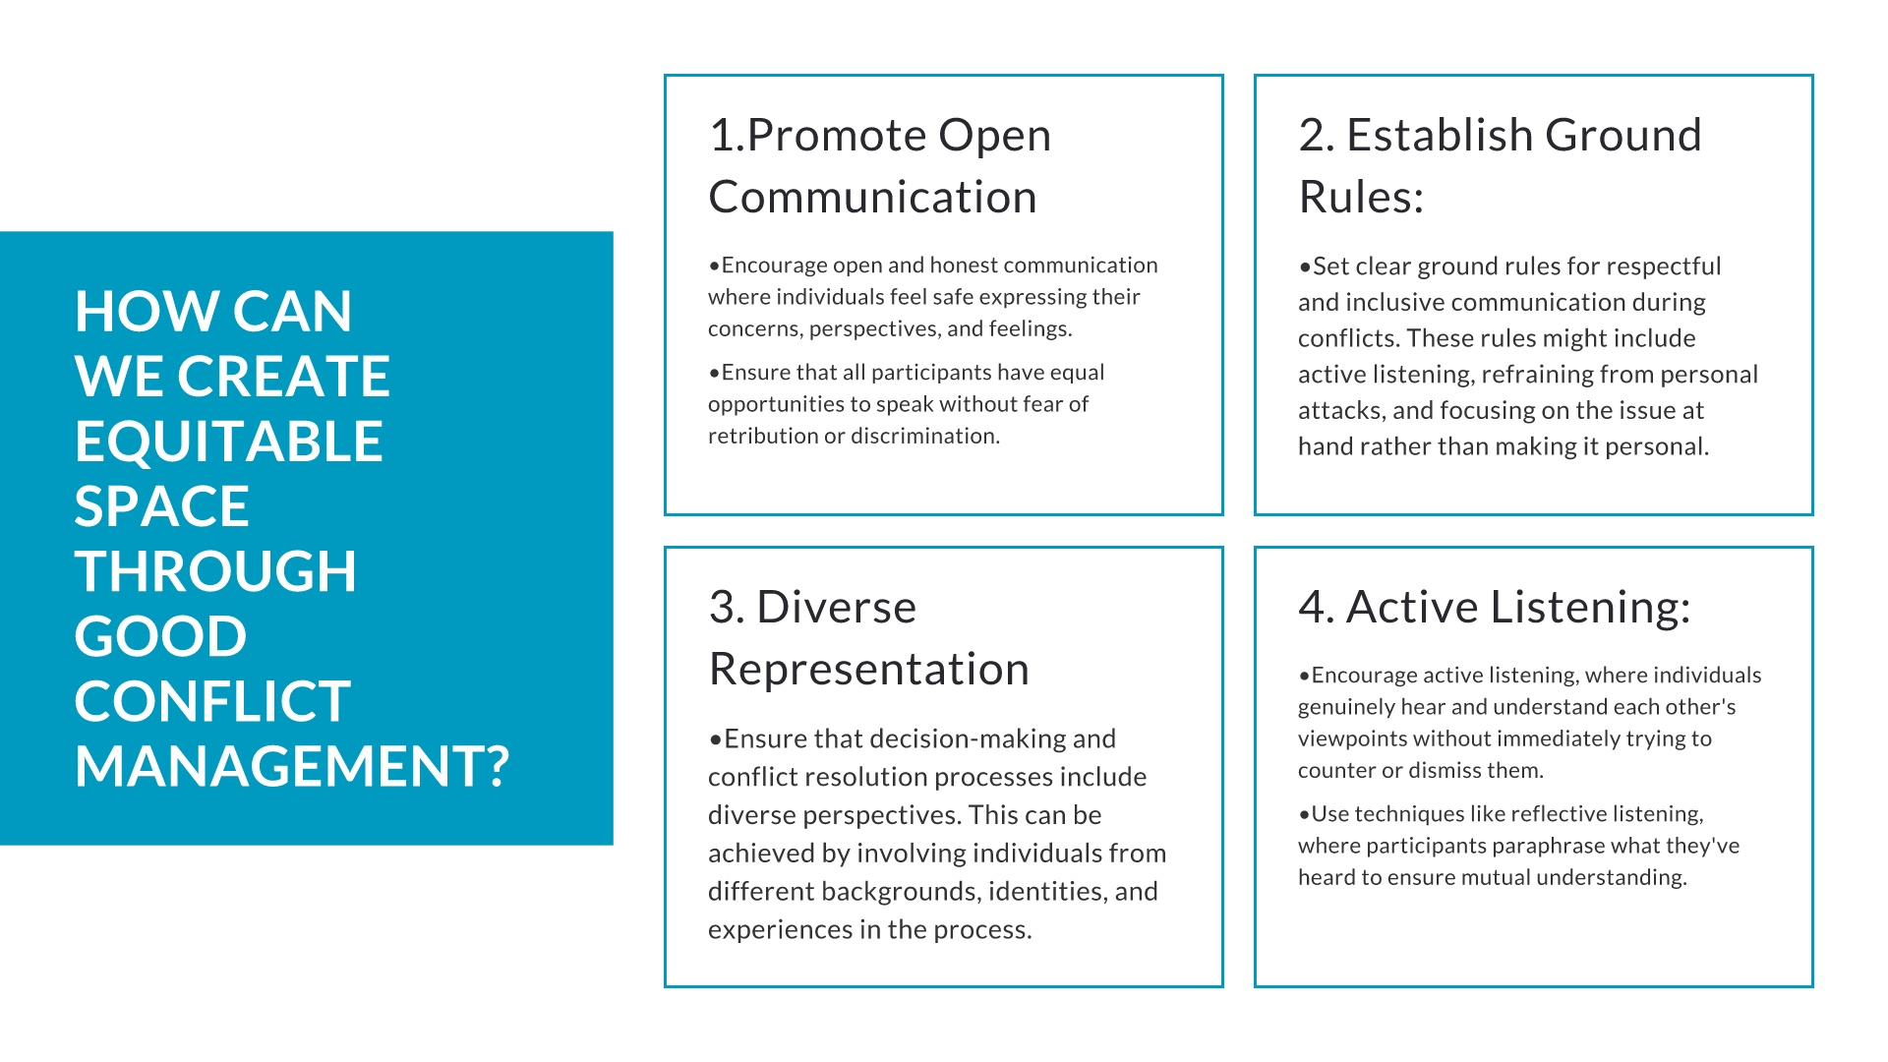
Notes:
How do my habits, preferences, tendencies, and internal biases inform and shape my communication? What would you like your teammates to know about your communication style? When communicating, what can another person do that you find frustrating?

Slide 38
Notes:
How do my habits, preferences, tendencies, and internal biases inform and shape my communication? What would you like your teammates to know about your communication style? When communicating, what can another person do that you find frustrating?

Slide 39
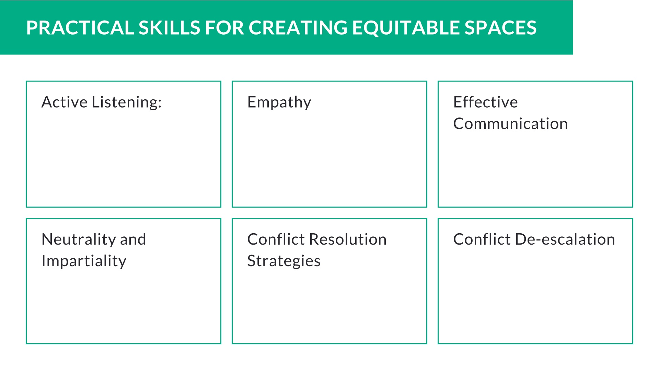
Notes:
How do my habits, preferences, tendencies, and internal biases inform and shape my communication? What would you like your teammates to know about your communication style? When communicating, what can another person do that you find frustrating?

Slide 40
Notes:
How do my habits, preferences, tendencies, and internal biases inform and shape my communication? What would you like your teammates to know about your communication style? When communicating, what can another person do that you find frustrating?

Slide 41
Notes:
How do my habits, preferences, tendencies, and internal biases inform and shape my communication? What would you like your teammates to know about your communication style? When communicating, what can another person do that you find frustrating?

Slide 43
Notes:
How do my habits, preferences, tendencies, and internal biases inform and shape my communication? What would you like your teammates to know about your communication style? When communicating, what can another person do that you find frustrating?

Slide 47
Notes:
There’s a farmer with a special orange that each of you wants to buy. It is a very rare variety and the last of its kind. There is ONLY one orange. Once you’re in your rooms, you’ll each get a backstory for WHY you want to purchase the orange from the farmer. While you’re waiting, pick your spokesperson. Each Team will pick ONE spokesperson. As a group, create your argument to present to the farmer about why he should sell the orange to your team. Talk as a group and decide what you want the spokesperson to say. Monique will play the “farmer” when you get back to the main room. She will decide who gets to purchase the orange. In this exercise, the group is divided into two teams “A” & “B” and each team is given a secret directive as to why they must purchase the orange owned by the farmer. Team “A” is told that they need the pulp to produce a high yield pharmaceutical that protects pregnant women from a deadly disease. Team “B” is told they need the rind to create a nuclear component that is needed to avoid the meltdown of a reactor, threatening thousands of lives. Only one spokesperson can negotiate with the farmer at a time. The most successful negotiators begin to collaborate with the other team instead of fighting harder for the last orange.

Slide 51
DURING THE CONFLICT CONVERSATION
Listen
Listening is NOT
Display genuine interest in what the other person has to say.
Be open to new information -- you don’t know what the other person will say.
Be patient; hear the person out.
Check your understanding of what was said.
Reflect back or summarize what you heard or understood
Responding with your own ideas
Simply waiting for your “turn” to speak
Problem-solving
Giving your opinion
Sharing your own experiences
Notes:
How do my habits, preferences, tendencies, and internal biases inform and shape my communication? What would you like your teammates to know about your communication style? When communicating, what can another person do that you find frustrating?

Slide 53
THANK YOU ALL SO MUCH!

