Slide 1
The Cultural Impact of Low Country Historical Foodways on Community Health
Who Are We?
Cultural History
Environmental & Energy Programming
Gullah Geechee Seafood Trail
Gullah Geechee/African American Farmers

Slide 2
To raise funds supporting the educational programs of the Gullah Geechee Chamber of Commerce
To create global awareness, profitability and sustainability of African American businesses and other entities impacting the Gullah Geechee community.
Notes:
in 2020, We founded the Gullah Geechee Chamber Foundation to raise funds supporting the educational programs of the GG Chamber of Commerce.
In 2018, the Gullah Geechee Chamber of Commerce was founded to create global awareness, profitability and sustainability of AA businesses and other entities impacting the Gullah Geechee community.
It is important to understand the Foundation was founded as a 501c3 to create an additional stream of revenue to support the Chamber in implementing programming in particular regarding economic development and environmental Justice
However, the work we do and will continue to implement can not happen without mutually beneficial partnerships, such as those represented tonight.

Slide 3
The Cultural Impact of Low Country Historical Foodways on Community Health
Cultural History
Environmental & Energy Programming
Gullah Geechee Seafood Trail
Gullah Geechee/African American Farmers

Slide 4
Who are the Gullah Geechee?
In the beginning
We are a language but so much more: water, land, music, spiritual practices, culture and keepers of the food…WE are an Evolutionary and Foundational Culture
Descendants of enslaved Africans from West and Central African who were brought to the Caribbean Islands, North and South America because of their knowledge of how to control the water and manage the land to grow the sugar, rice, indigo, and sea island cotton.
Our ancestors were chefs, engineers, builders, medicine/root doctors and keepers of the water and land.
Notes:
Gumbo,
Chicken Perloo,
Friday night Fish Frys
Oysters
Crab Cracks

Slide 5
Transatlantic Slave Route

Slide 6
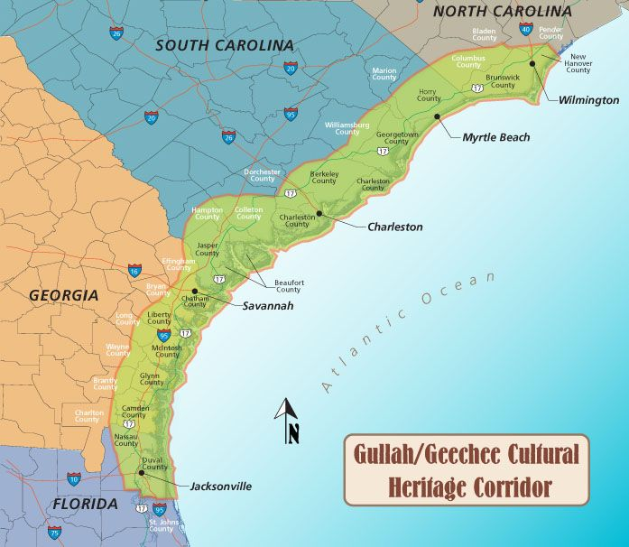
Notes:
In 2006, the US Congress passed the “Gullah/Geechee Cultural Heritage Corridor Act,
Laying the cultural ground work for economic opportunity through cultural heritage tourism, most recently quantified with data in the 2020 Report Market for Gullah Geechee Heritage Tourism.

Slide 7
Defining Gullah Food
The main thing is Gullah food is a lot more slow cooking , one-pot cooking, living oﬀ the land, the use of the benne seed, the use of ground nuts. Gullah cuisine is [also] a lot more of the African Diaspora, you see a lot more of the Caribbean ﬂavors
Gullah Recipes are based on rice, simmered vegetables, and fresh seafood. Specifically, oysters, shrimp, grits, and okra are commonly incorporated. These beloved, cultural dishes boast rich history and even richer flavors
Notes:
Combination of African foods and traditions with European and Native American Foods and traditions
BBQ
Gumbo,
Chicken Perloo,
Friday night Fish Frys
Oysters
Crab Cracks
Flavorful; more herbs/less salt

Slide 8
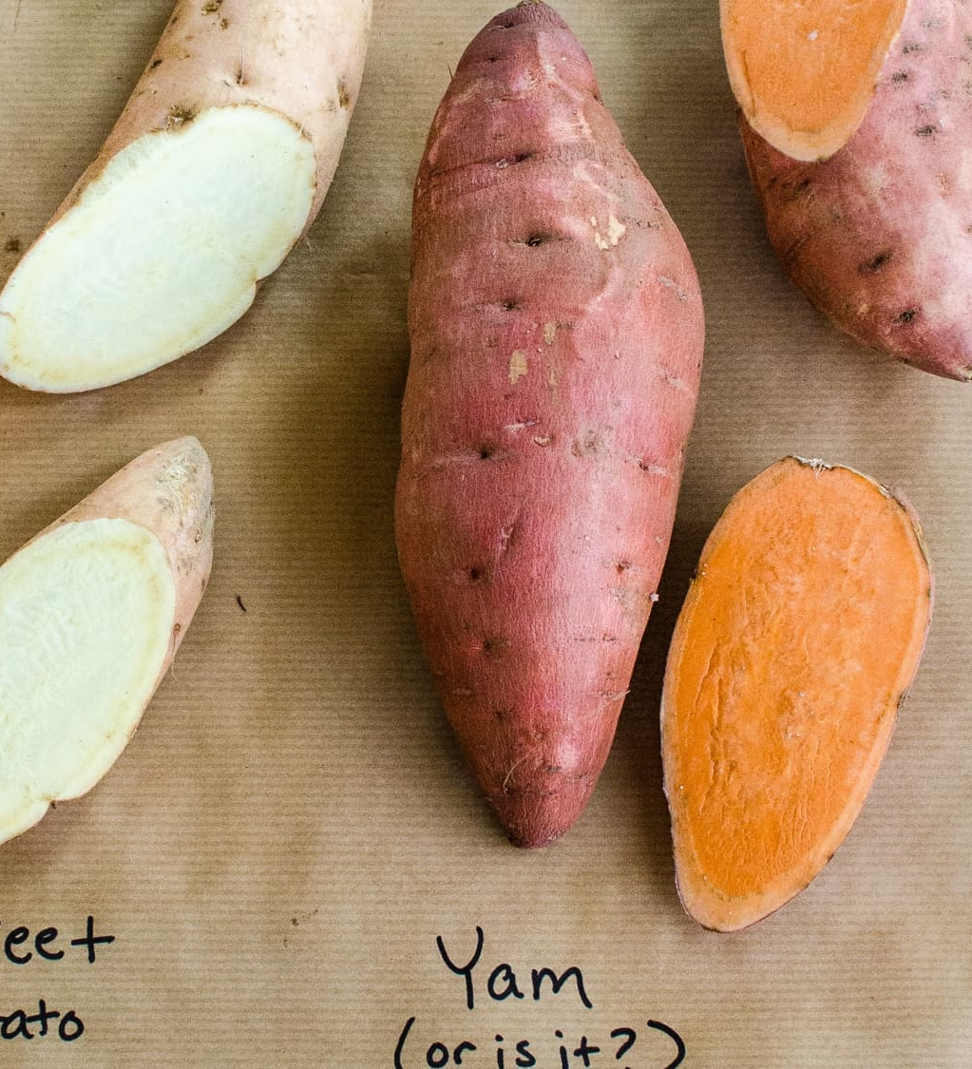
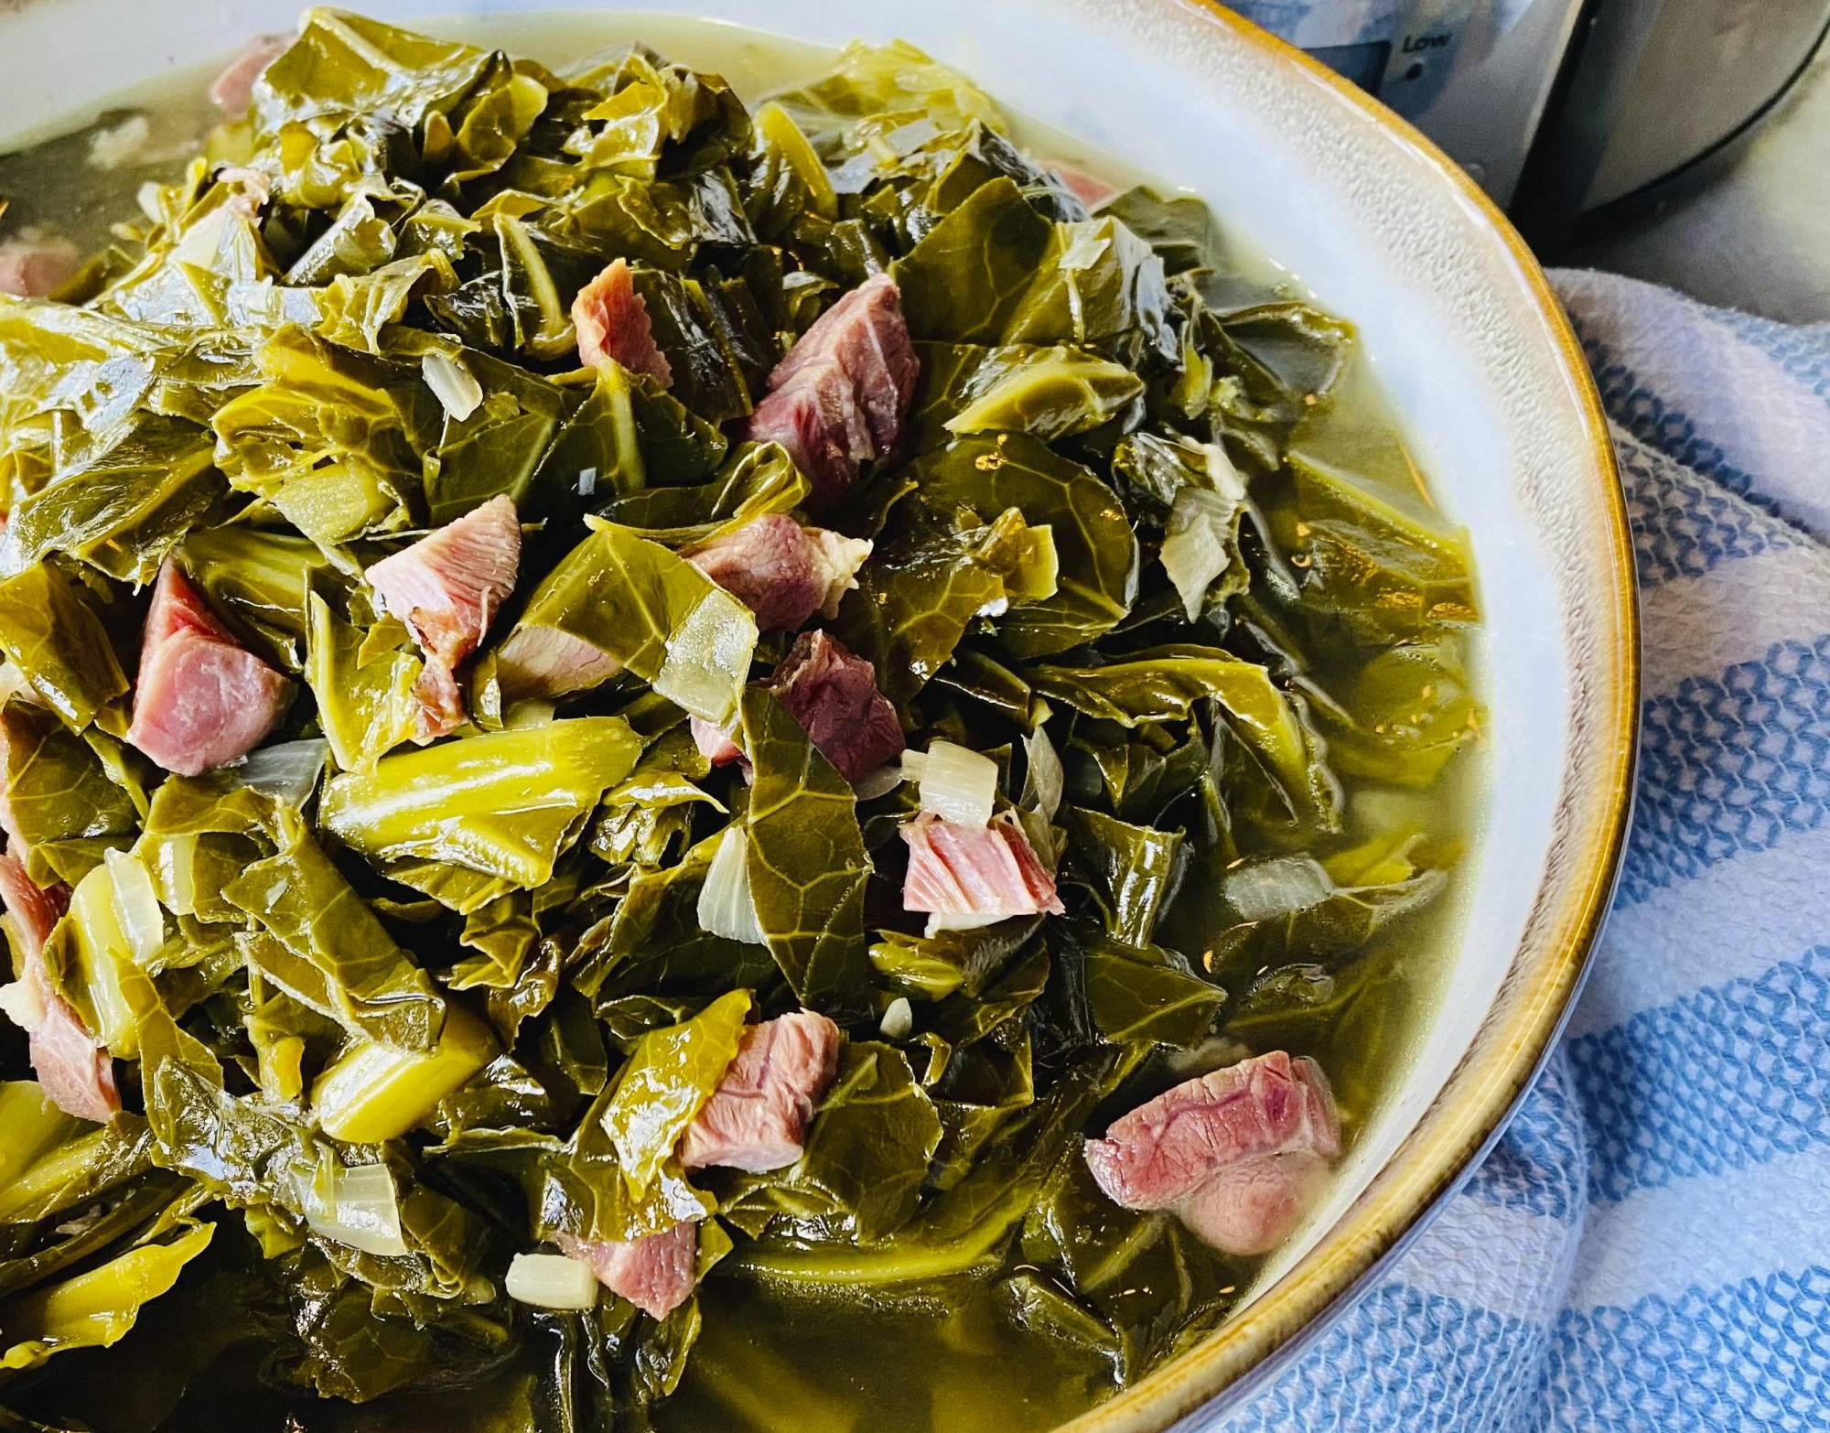

Slide 9
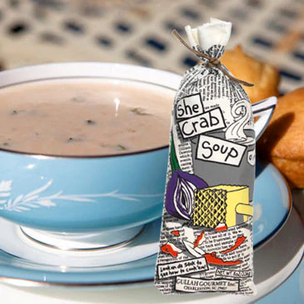
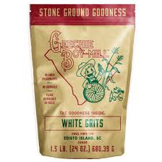
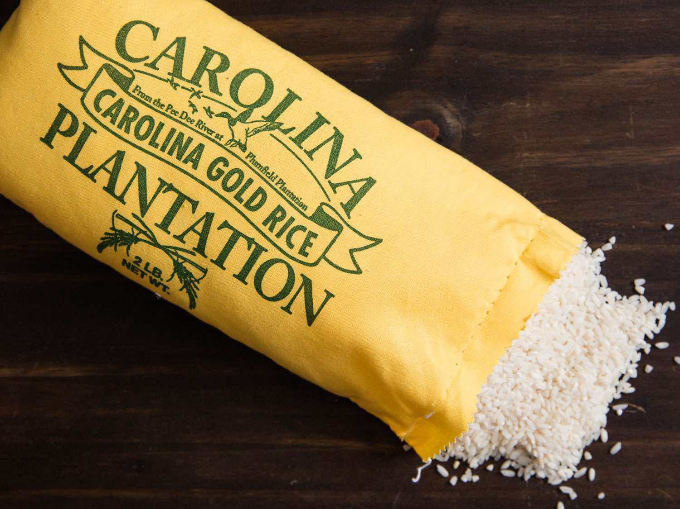
Hidden cultural impact
Notes:
It is important to define the AA Tourism so that we understand the Black Cultural Heritage tourism context of where we start, where we are going and the global opportunity before us; The Gullah Geechee Chamber is currently participating in Black Cultural Heritage Global certification to provide as a conduit to a global tourism market

Slide 10
“They eat what? New Year's food traditions around the world”
Courtesy of CNN Travel

Slide 11
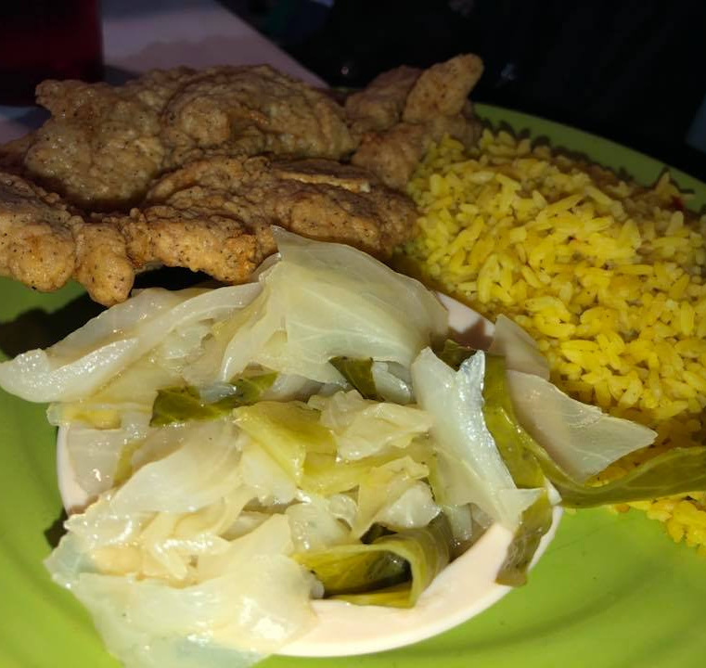
Gullah Cooking vs Soul Food vs Southern Cooking
Gullah Food and cooking is foundational and based on simmering, one-pot meals, herbs for “taste”, rice, seafood, beans; “more direct from the water and land”, incorporating other cultural flavors
Soul Food – more fried foods, increased of salt; faster cooking methods, more prominent in the 1960’s and urban environments.
Southern Foods – More rural, fried and starchy foods, broader traditions

Slide 12
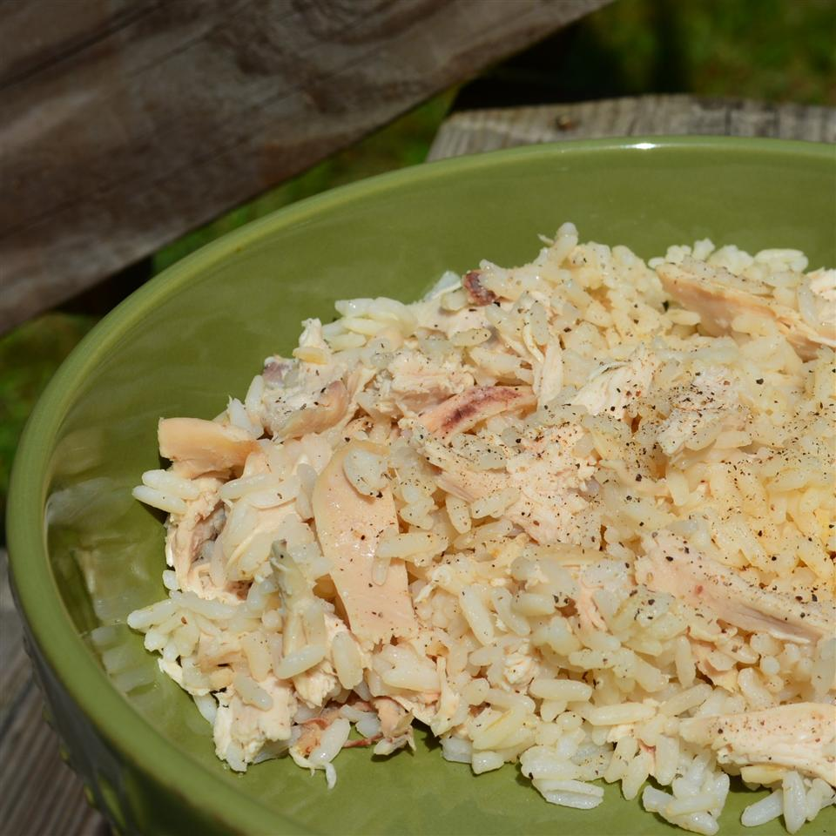
Perloo
Perloo vs. Bog…yes, there is a difference
bog
Notes:
It is important to define the AA Tourism so that we understand the Black Cultural Heritage tourism context of where we start, where we are going and the global opportunity before us; The Gullah Geechee Chamber is currently participating in Black Cultural Heritage Global certification to provide as a conduit to a global tourism market

Slide 13
The Cultural Impact of Low Country Historical Foodways on Community Health
Environmental & Energy Programming
Gullah Geechee Seafood Trail
Gullah Geechee/African American Farmers

Slide 14
Gullah Geechee Environmental & Energy Programming
Gullah Geechee Environment & Energy Roundtables – Small focus groups of 12 - 15 persons hosted by the Gullah Geechee Chamber Foundation throughout our community to determine the levels of knowledge and the work being done in regarding the impact of climate change, career and business opportunities in green, renewable energy, and environmental justice.
Gullah Geechee Environment & Energy Conversations – Monthly conversations between environment/energy organizations and the Gullah community to “be a resource to each other” through the exchange of ideas, missions and to advocate with and for the community.
The Gullah Geechee Environment & Energy Conference - an annual Conference hosting Environment, Energy and Cultural speakers and panels with a focus on sharing knowledge regarding the impact of Climate Change, career and business opportunities in green, renewable energy, electric vehicles and the training of activists to advocate for the community and its role in the future of solar, wind, green hydrogen and other energy sources
Notes:
Environmental and Energy Programming

Slide 15
Collaborative Partners
Notes:
We can not implement this game changer alone. Our collaborative partners working with us on the Gullah Geechee Seafood Trail beginning with the SC Sea Grant Consortium with Susan Lovelace, director and Matt Gorstein vice director
SC AA Heritage Commission and WeGOJA Foundation with Dawn Dawson-House and Jannie Harriott
Gullah/Geechee Nation And the Gullah/Geechee Fishing Association represented by Queen Quet
WeGOJA Foundation, and of course Athenaeum Press at Coastal Carolina University, Alli Crandell

Slide 16
The Cultural Impact of Low Country Historical Foodways on Community Health
Gullah Geechee Seafood Trail
Gullah Geechee/African American Farmers

Slide 17
Gullah Geechee Cultural Heritage Tourism potential
$34 Billion annually
Source: 2020 Market Research Report for Gullah Geechee Heritage Tourism; Gullah Geechee Cultural Heritage Corridor NHA
Notes:
Key Findings
The potential leisure spending for the GG Corridor states is $34 Billion annually.
With the largest category of trip expenditures being Food & Beverage with a spending average of $250 …People want to “experiencing Local cuisine” is the most popular activity cited by 65% of the travelers polled for this market research plan…thus setting the stage for showcasing of Gullah Geechee foodways.
But visitors/tourists also want to experience the culture, learn more about the culture and spend their money…

Slide 18
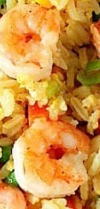
Gullah Geechee Seafood Trail
Promoting Gullah Geechee Maritime Cultural Heritage and Enhancing Economic Resilience through a Gullah Geechee Seafood Trail
Notes:
Gullah Geechee Seafood Trail
GG Chamber Foundation was awarded a $283,000 grant from NOAA and NMFS and the mission of the grant is
Promoting Gullah Geechee Maritime Cultural Heritage and Enhancing Economic Resilience through a Gullah Geechee Seafood Trail

Slide 19
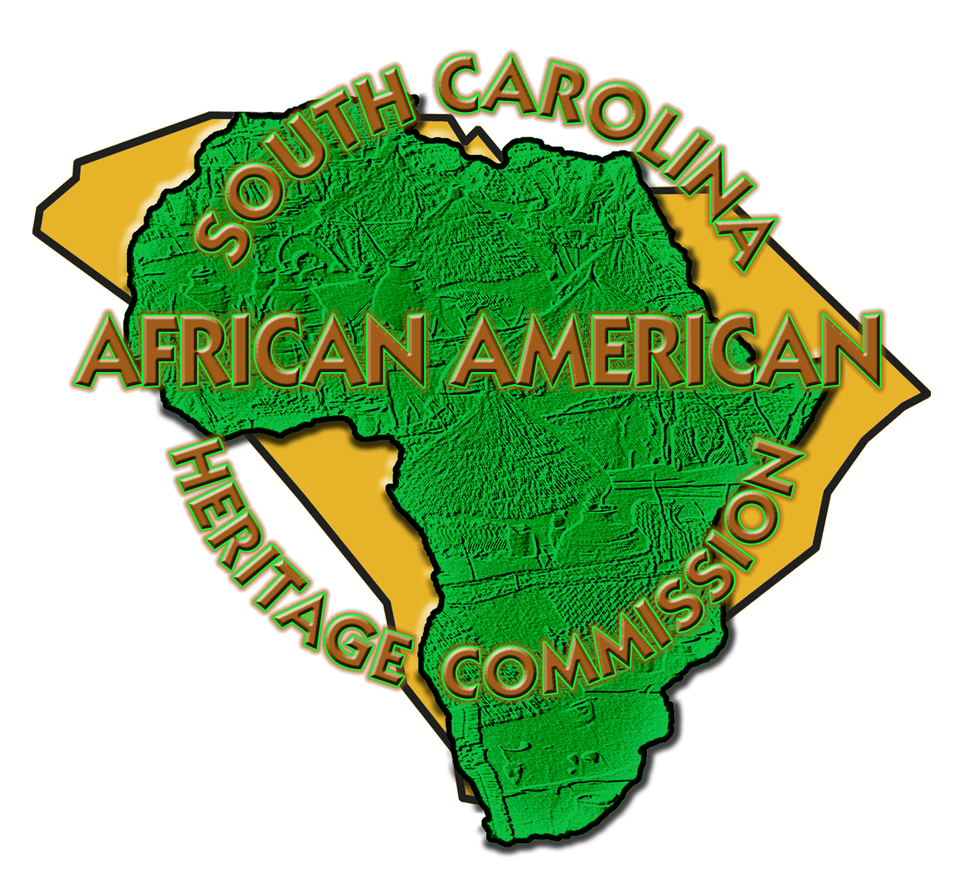
Collaborative Partners
Notes:
We can not implement this game changer alone. Our collaborative partners working with us on the Gullah Geechee Seafood Trail beginning with the SC Sea Grant Consortium with Susan Lovelace, director and Matt Gorstein vice director
SC AA Heritage Commission and WeGOJA Foundation with Dawn Dawson-House and Jannie Harriott
Gullah/Geechee Nation And the Gullah/Geechee Fishing Association represented by Queen Quet
WeGOJA Foundation, and of course Athenaeum Press at Coastal Carolina University, Alli Crandell

Slide 20
The Cultural Impact of Low Country Historical Foodways on Community Health
Gullah Geechee/African American Farmers

Slide 21
Farmers network

Slide 22
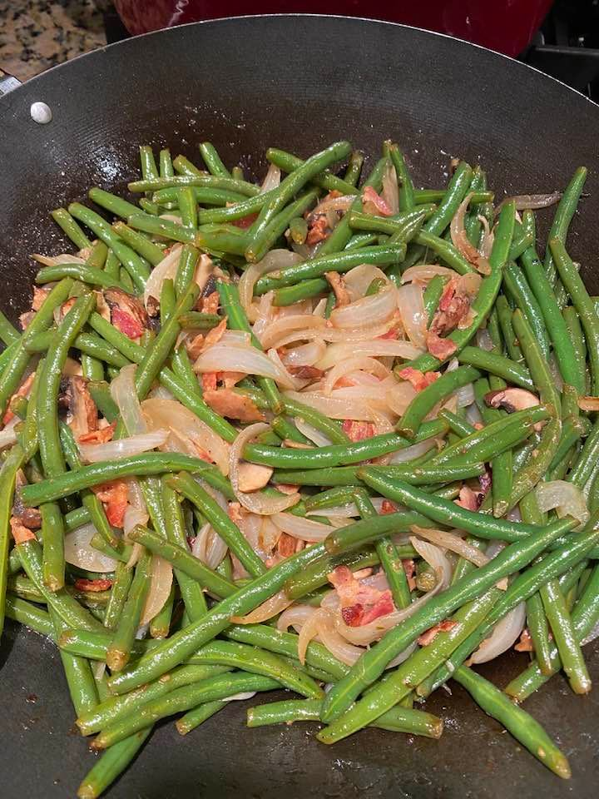
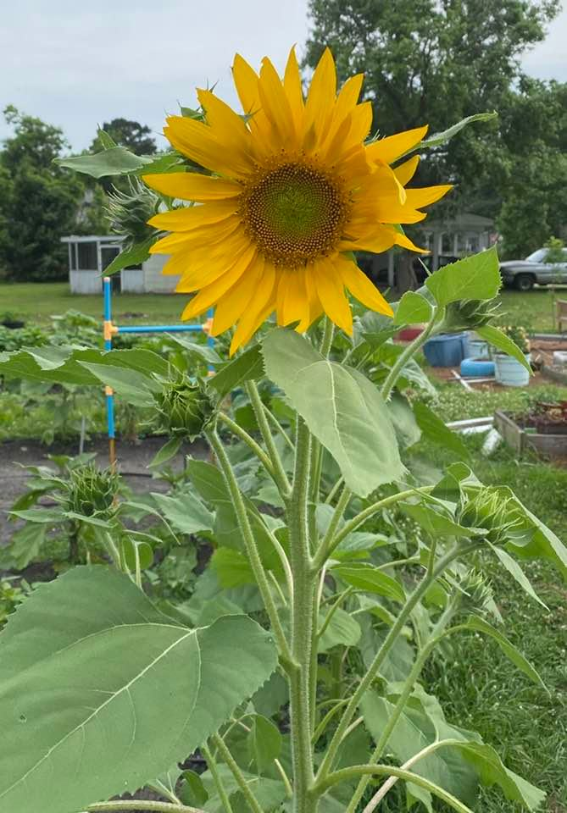
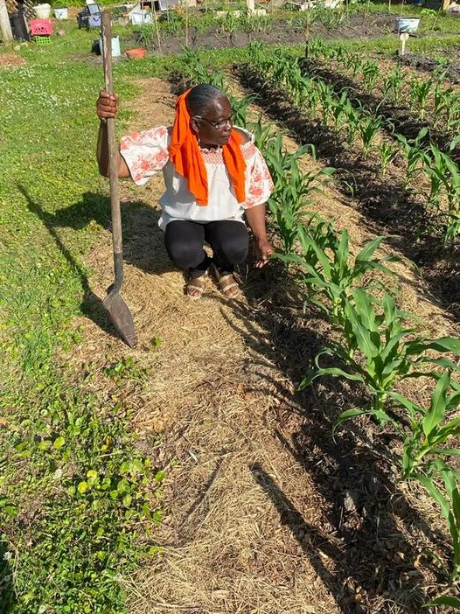
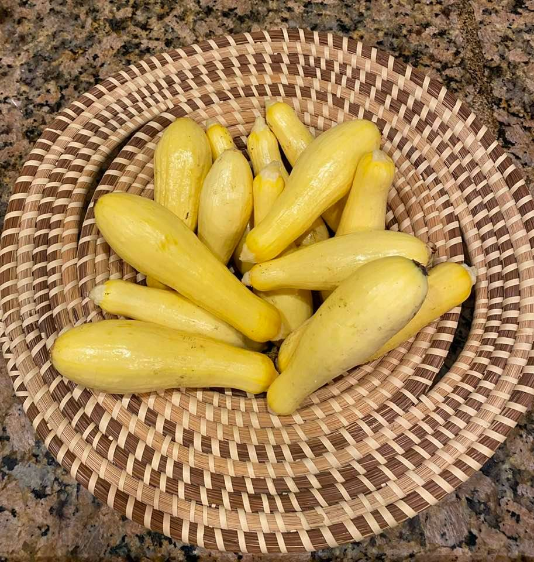
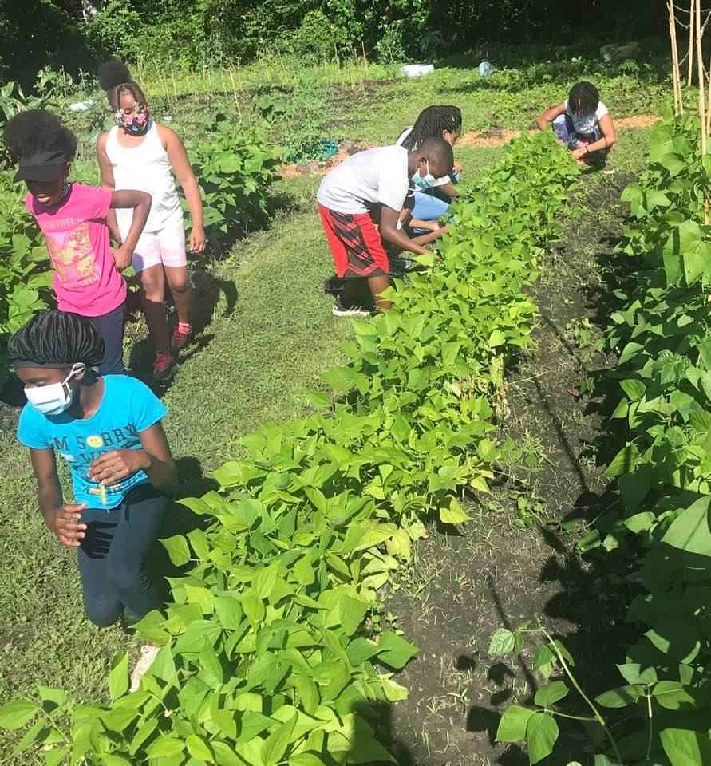
Gullah preservation society community garden
Notes:
It is important to define the AA Tourism so that we understand the Black Cultural Heritage tourism context of where we start, where we are going and the global opportunity before us; The Gullah Geechee Chamber is currently participating in Black Cultural Heritage Global certification to provide as a conduit to a global tourism market

Slide 23
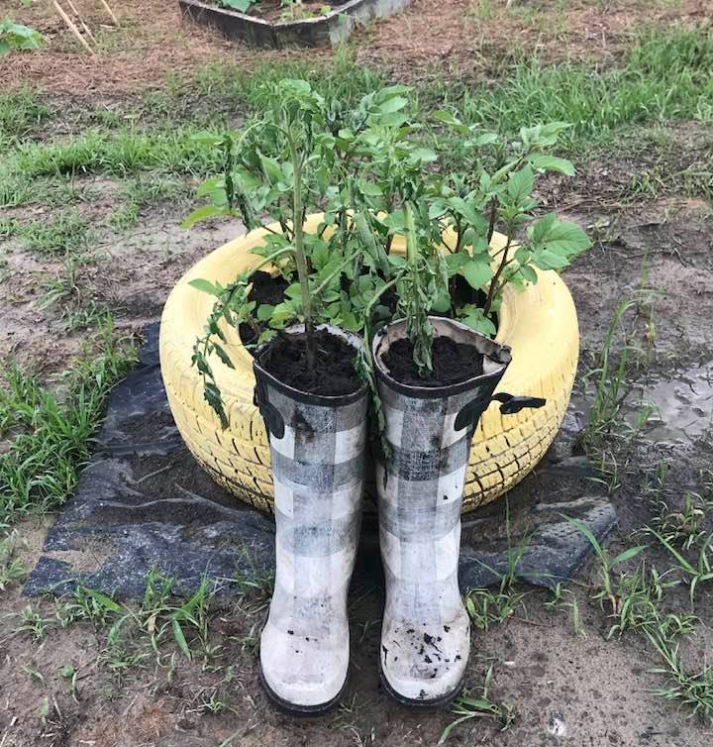
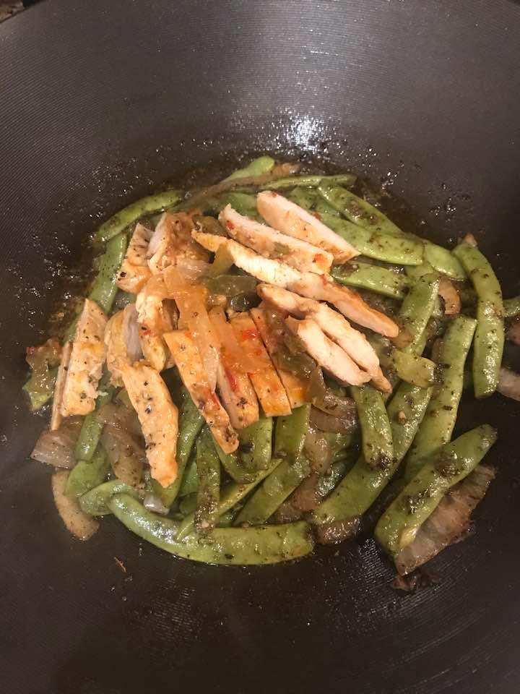
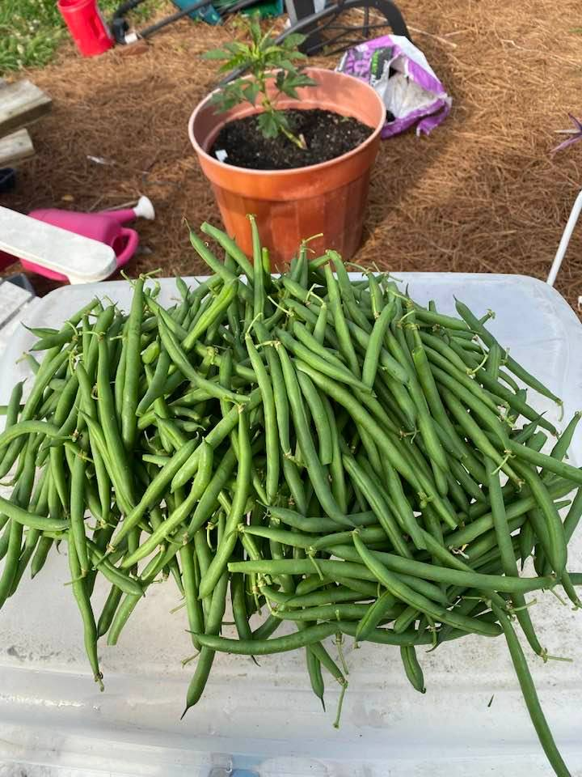
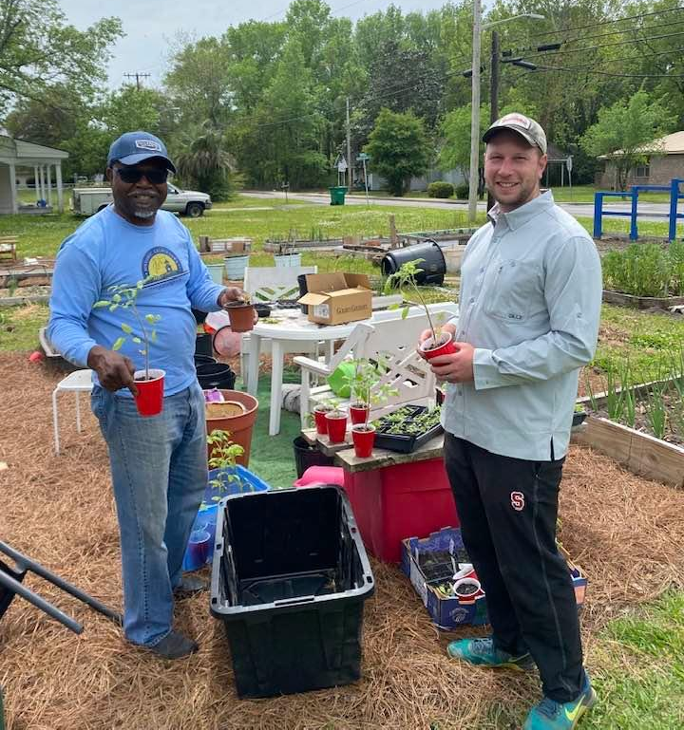
Gullah preservation society community garden
Notes:
It is important to define the AA Tourism so that we understand the Black Cultural Heritage tourism context of where we start, where we are going and the global opportunity before us; The Gullah Geechee Chamber is currently participating in Black Cultural Heritage Global certification to provide as a conduit to a global tourism market

Slide 24
CHALLENGES to health equity
Lack of Infrastructure – a structure of ownership
Low representation of Culturally-Embedded, Sustainable businesses
Climate Change/Environmental Justice
Disconnect from Gullah Geechee culture
Cultural Appropriation
Not of the community; selling community assets
Notes:
Challenges:
Lack of infrastructure – We are finding low ownership of shrimp boats, seafood businesses, lots of restaurants but low numbers of suppliers or lack of capacity to ramp up production
Cultural Appropriation
Access to financial and People Capital
Absence of Generational Wealth
Climate Change/Environmental Justice
According to the Southern Environmental Law Center and its sources:
In the last 50 years, the Southeast US has lost more than 55% of its coastal wetlands.
81% of coastal wetlands in the contiguous US are in the Southeast region.
Over 75% of the US commercial fish and shellfish harvest is wetland dependent.

Slide 25
SOLUTIONS
Create Infrastructure:
End Cultural Appropriation
Increase people and financial capacity
Develop Collaborative Partnerships
Address Environmental Issues:
Address Impact of Climate Change
Build Relationships with the Scientific Community
Support Community-based Leadership and Solutions addressing Environmental Justice
Education
Introduce Gullah Geechee University
Create a cultural knowledge base
Build Sustainable small and micro business ownership
Connect Culture to Health Equity
Notes:
Solutions:
Create Infrastructure
Address Environmental Issues
We are inherently tied to the water and the land. Our Ancestors were brought to the Islands, North and South America because of their knowledge of how to control the water and manage the land. Our success depends on the quality and health of the water and land.
That’s it. Healthy Environment = Healthy People = Healthy Communities = Healthy Businesses

Slide 26
Culturally-Embedded Business Course
Business Boot Camps
Stand-alone, refresher classes
Creator Workshops/Pop-up Shops
Thank you, Horry County Government! for your investment of $61,000 over two years allowing small- and micro-business owners in the Bucksport area to participate in cultural heritage tourism.
Notes:
Gullah Geechee University

Slide 27
?
Contact
843-318-8644
Marilyn@GullahGeecheeChamber.org
Mak’n Somet’n from Not’n
Notes:
Questions and Answers

Slide 28
Funded by the NOAA Saltonstall-Kennedy Grant Program
Notes:
Good Afternoon! It’s great to be with you today. Thank you for sharing your time with the Gullah Geechee Chamber family organizations and our collaborative partners. I want to take the next 15 minutes and share with you our plans for the next two years and beyond for the Gullah Geechee Seafood Trail funded by the National Oceanic Atmospheric Administration and National Marine Fisheries Services.

