Slide 6
Notes:
Know your buttons! Mute, camera on/off, raise hand!

Slide 8
Notes:
CODE: 5448 0102 or Link:https://www.menti.com/vsd7du9bj1 https://www.menti.com/vsd7du9bj1

Slide 17
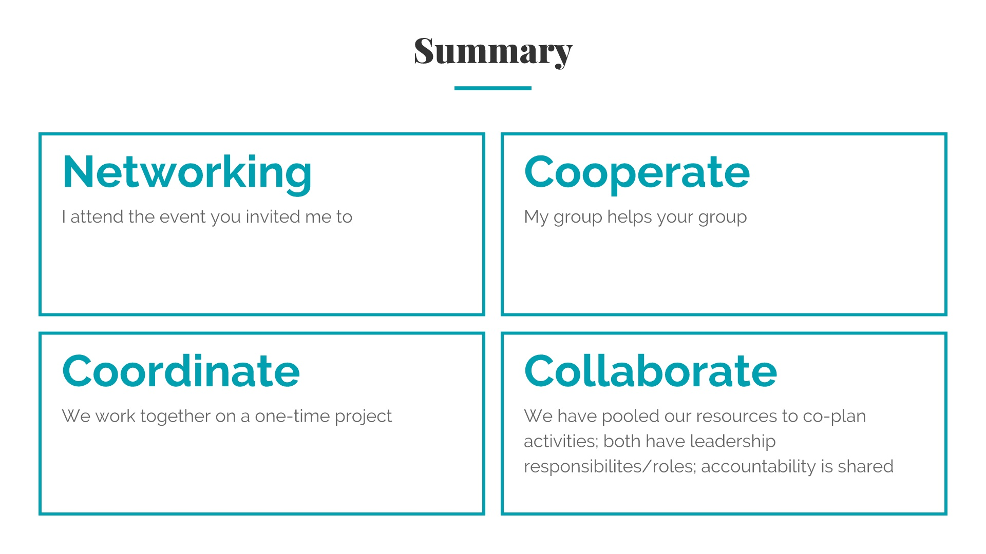

Slide 32
Notes:
Lunch break:7 mins total https://www.youtube.com/watch?v=xjtPMiumixA https://www.youtube.com/watch?v=KhfkYzUwYFk

