Slide 1
Union Medical Center Improving the Social Determinants of Health and Health Equity in a Rural Community

Slide 2
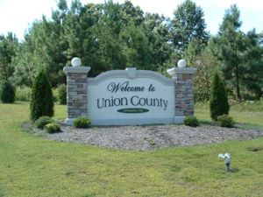
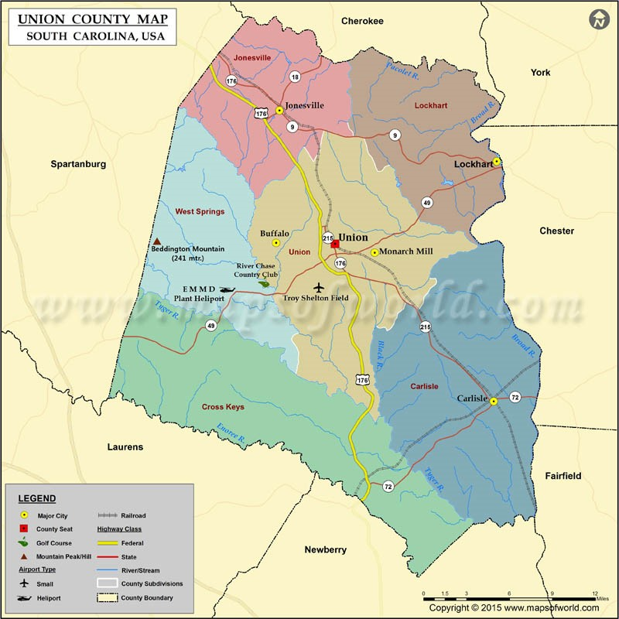
Population: 27,306 ​ Source: US Census Bureau​ County Seat: Union​ Largest City: City of Union, 8,039​ Major Highways: US 176, SC 9, SC 49, SC 215​

Slide 3
Community Activities
Union County Public Health Task Force is now:

Slide 4
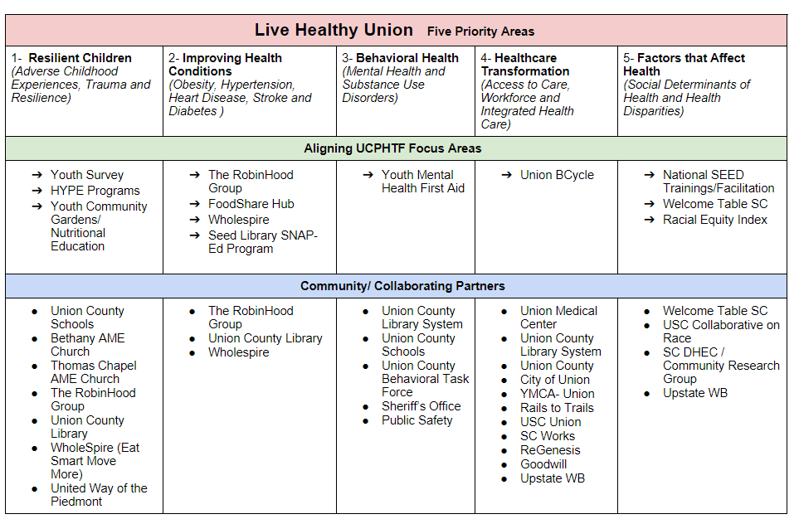
Community Activities

Slide 5
Union Medical Center
Live Healthy Union Healthcare Partners:
Union Medical Center
Access Health
ReGenesis Healthcare
Spartanburg Regional Healthcare System
Union County Behavioral Health Task Force
Alliance for Healthier Generation
SC Office of Rural Health

Slide 6
Union Medical Center
Live Healthy Union Governmental Partners:
SC DHEC
Union County Government
City of Union
City of Jonesville
City of Carlisle
SC Works
Upstate Workforce Investment Board
SC Department of Social Services
Healthy U Behavioral Services
Union County Library System

Slide 7
Union Medical Center
Live Healthy Union Educational Institutions Partners:
University of South Carolina-Union
Spartanburg Community College
Union County School District
Union County First Steps
Clemson University SNAP-ED

Slide 8
Union Medical Center
Live Healthy Union Community and Faith Based Partners:
Union County Family YMCA
RobinHood Group
United Way of the Piedmont
Bethany AME Church
Thomas Chapel AME Church

Slide 9
Union Medical Center

Slide 10
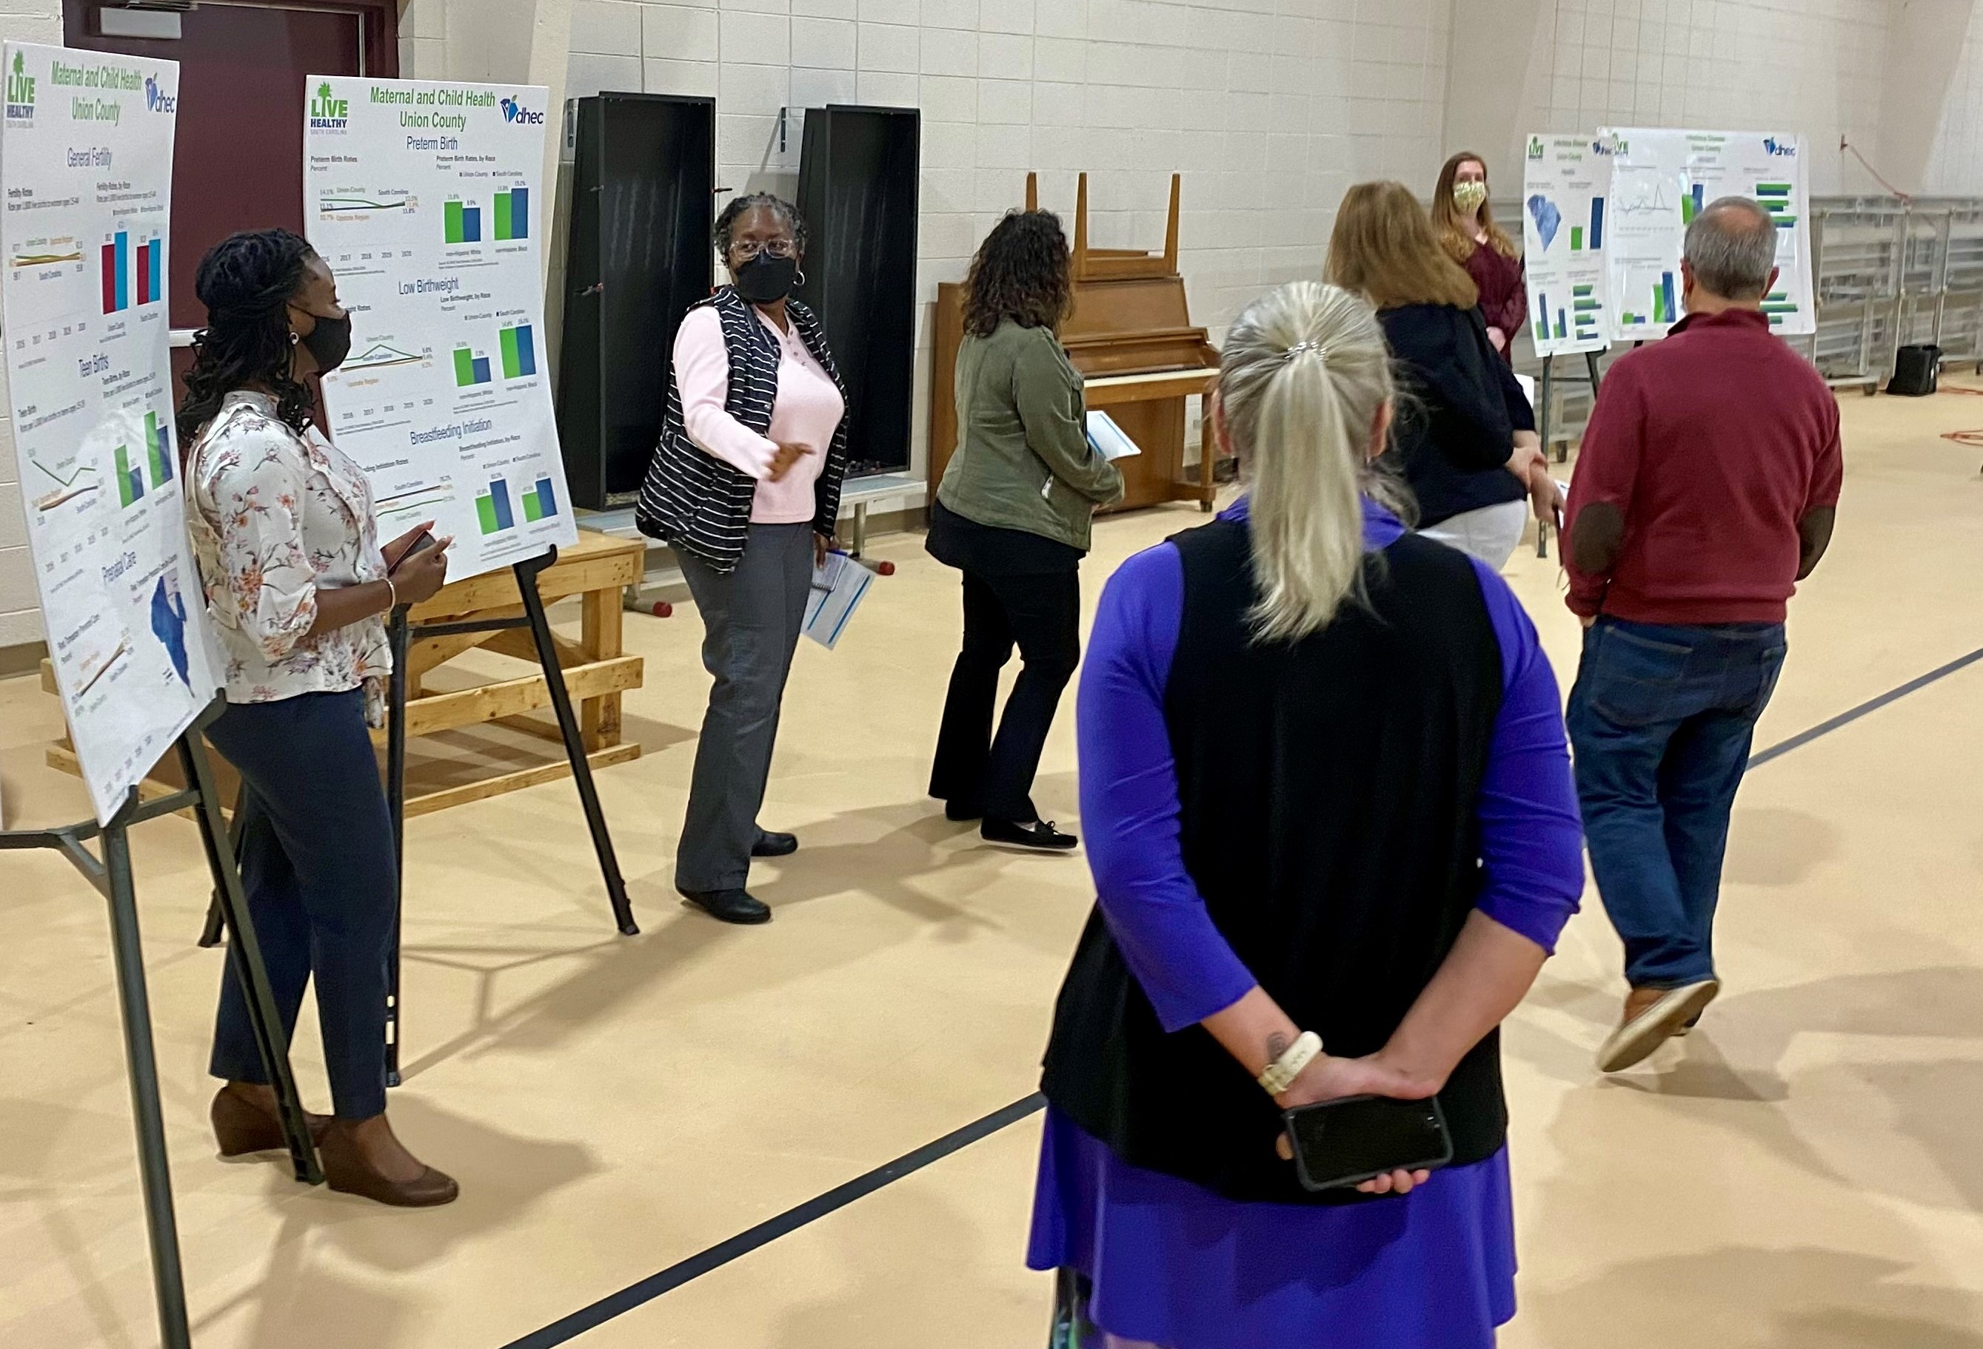
Community Activities
On Friday February 18th Live Healthy Union collaborated with the SC DHEC to put on the first ever Data Walk for Union County. This was held on the USC Union Campus with the community leaders and open to the public. DHEC presented posters around the room with detailed

Slide 11
Union Medical Center
Goals/Objectives
From the Data Walk presented by SC DHEC we realized we did not have a good understanding of the healthcare needs of the various segments of our population. We needed to get this data in order to target education, health screenings and pop-up clinics and diagnostics to improve health outcomes for all.

Slide 12
Union Medical Center
Goals/Objectives
Create list of data points we feel would be required to adequately analyze the unmet health needs in Union County.
Work with quality and IT departments to determine what necessary data is available in our Epic electronic medical record system and create a Dashboard to capture the data in the format needed.
There are 3 areas of high incidences in Union that we are aware of:
Diabetes
Heart Disease
Prostate Cancer
We need to utilize the dashboard in a way to better understand how to address these health issues.

Slide 13
Union Medical Center
Prostrate Cancer Awareness

Slide 14
Union Medical Center
Measures of Success
Patient Access team, case managers and care transition team trained in capturing pertinent social determinants of health data in Epic to use for dashboard.
Show an increase in the percentage of patient records with Race, Ethnicity and Language (REAL) data fields completed.
Implement cultural competency training throughout Union Medical Center.
Review equity dashboard each quarter for signs of improved measures.
Through shared community involvement, focus on areas of need following the path of the Union Community Health Improvement Plan using new data collected.

Slide 15
Union Medical Center
Project Justification
As part of Live Healthy Union, we partnered with SC DHEC to have a Data Walk open to the public in Union. There were several disparities that jumped out which were quite alarming and showed the need to take action to narrow the health equity gap. A few of the areas are listed below:
Delayed medical care due to cost: 17.6% for non-Hispanic White population
23.7% for non-Hispanic Black population
Stroke deaths by sex and race 50.8% for non-Hispanic White female population
74.2% for non-Hispanic Black female population
New Cases of Prostate Cancer 97.3 for non-Hispanic White male population
(per 100,000 pop) 235.5 for non-Hispanic Black male population

Slide 16
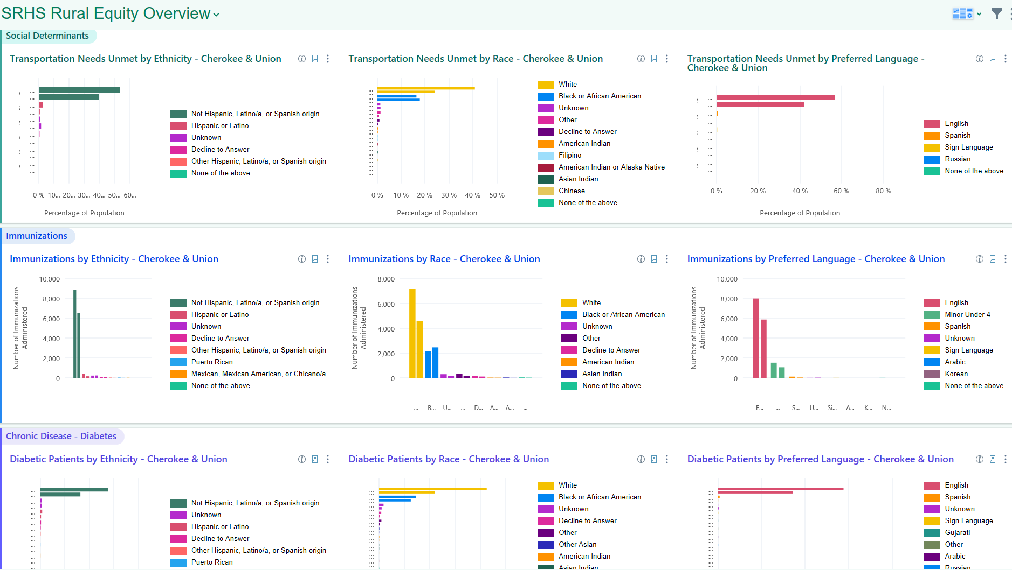

Slide 17
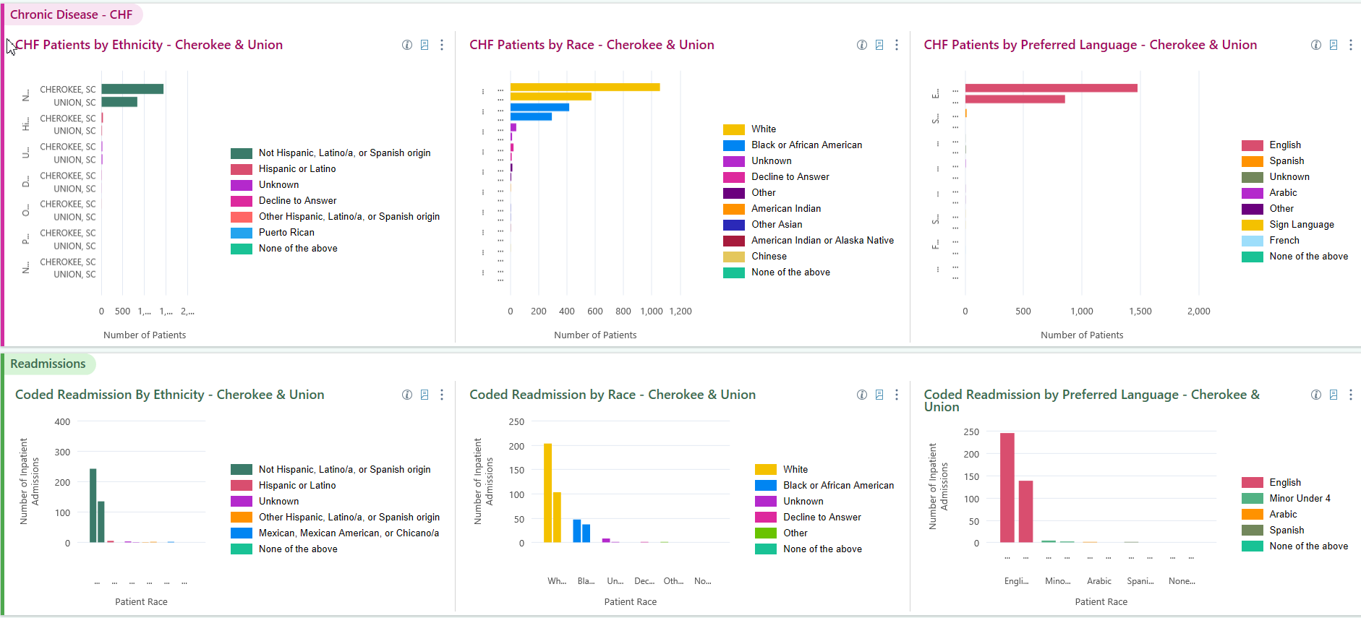

Slide 18
Challenges
Our biggest need is to increase education for those inputting the data and making sure they understand it.
We also need more training for users of the dashboard on the slicer dicer tool to customize the report for even great use for us.

Slide 19
Future DEI Program at Union Medical Center
We plan to use the information collected from the dashboard to help guide our Live Healthy Union team on community wide programs targeting the population identified.
We will also include the dashboard in the education of our physicians and care givers to have a better understanding of our population.
Continue to have DEI, Health Equity on Annual Operating Plan
Increase Leadership diversity through a newly created Leadership Development Academy to begin in the fall 2023.

Slide 20
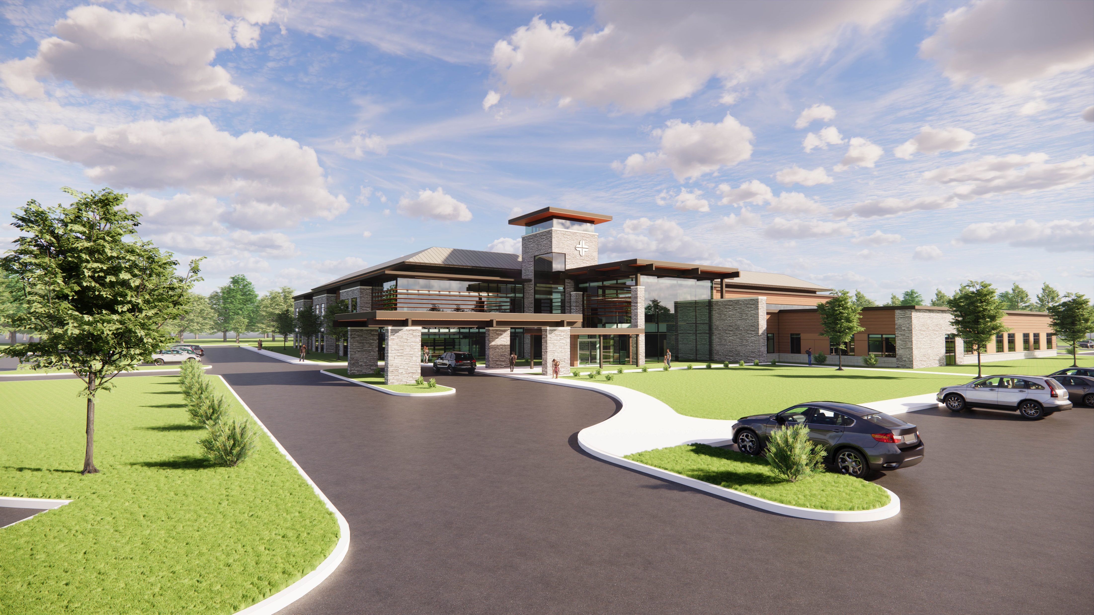
Future Union Medical Center Announced 2-23-2023

Slide 21
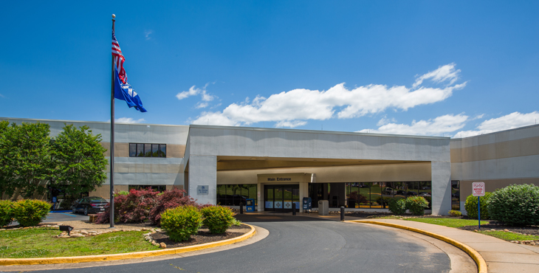
Rural health dei learning collaborative

Slide 22
Key Partners
External
Community Based: KNOW (2), Meals on Wheels, Wholespire Cherokee, FoodShare Cherokee, Farmers Market
Governmental: SC DHEC, Upstate Workforce Investment Board, City of Gaffney, Cherokee County Govt
Healthcare: SRHS, CMC, ReGenesis, Access Health, Peachtree, Ivy Grove, Palmetto Patriots Home
Education: Clemson SNAP-Ed, Cherokee County School District, SCC Cherokee
Internal
Case Management
Hospitalists
ER Providers
Medical Group of the Carolinas
Quality
Hospice
Home Health

Slide 23
Goals/Objectives/Tactics
Identify elements/disease categories in order to create a health equity dashboard
Congestive Heart Failure
All Cause 30 Day Readmissions
Diabetes
Work with key stakeholders, including IT, to develop dashboard in EPIC to continually monitor identified disease categories listed above
Use data to make informed decisions on improving care processes and decrease health disparities
Share data with community partners to further enhance overall health in the community
Complete Health Equity Dashboard by end of CY 2022

Slide 24
Measures of Success
Better understanding of data for correlations in disparate groups
Increased collaboration among health care providers and systems in Cherokee County
Sharing of data with KNOW (2), Wholespire, EPS providers and other key stakeholders
Improvement in key health indicators such as
Decrease in overall Heart Failure mortality rate
Decrease in preventable Heart Failure readmissions
Decrease in preventable All Cause Readmissions

Slide 25
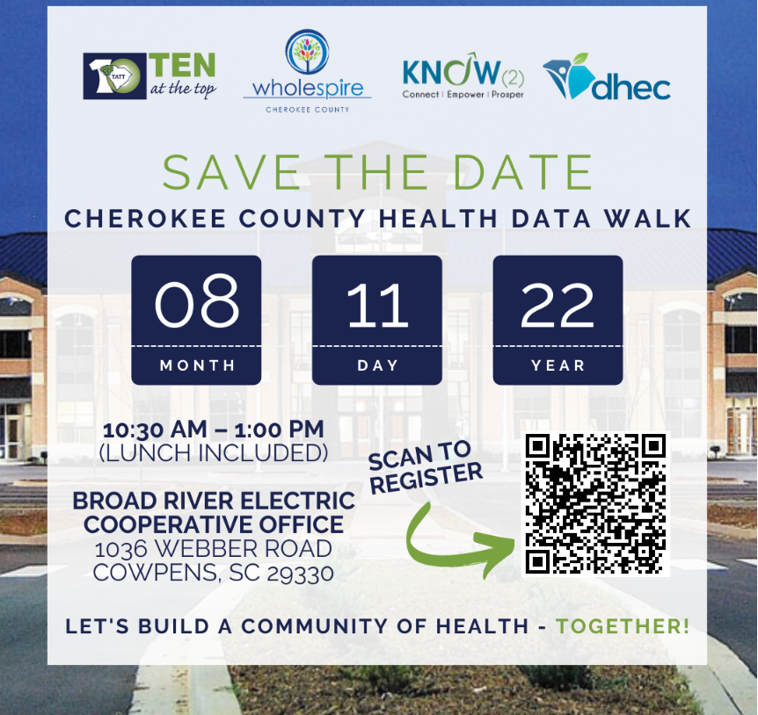
COMMUNITY PARTNERSHIPS & EVENTS
Cherokee County hosted a data walk to view key health data points for the county. The business community, local residents, and community leaders, attended and were part of developing the Community Health Strategy for Cherokee County.
The Community Health Improvement Plan (CHIP) was implemented as outlined in our health system's Annual Operating Plan to "Improve Health Equity in Collaboration with Community Organizations". The CHIPs are available in English, Spanish and Russian as a 3-year action plan is to improve health in priority areas focusing on Access to Care, Behavioral Health, Chronic Health Conditions and Resilient Children & Families.

Slide 26
Actions
Internal working group committed to customize and improve discharge process to ensure clear instructions and acquisition of appropriate tools for self care and follow-up.
Gearing up for second school year for Project Search students in house. Provides environment and training for disabled young adults to learn job skills to set them up for successful employment potential.
Reviewing data from other community and county sources to identify potential barriers to health care or disparities in delivery for investigation.

Slide 27
ACCOMPLISHED OBJECTIVES AND/OR TACTICS WHAT HAVE WE DONE TO ACCOMPLISH OUR DEI PROJECT AT CMC?
Dashboard completed
Updates in real time as patient encounters entered into the system
15 elements in 5 groupings, each displayed by race, ethnicity and preferred language
Grouping topics include
Transportation needs unmet
Immunizations
Diabetic patients
Heart failure patients
Coded readmissions
Data review compared to Cherokee population shows
Higher ratio of Black/AA diabetic patients than white (7%)
Higher ratio of Black/AA heart failure patients than white (10%)
Lower ratio of Black/AA readmission patients than white (3%)
Over 60% of respondents reported transportation challenges

Slide 28
Other Metrics
Heart Failure Mortality: 1 case in June of 22
All Cause Readmission rate: varies from as low as 7% month to month
Heart Failure Readmissions: 1 to 2 cases per month
Most Heart Failure cases are Caucasian
All cause readmission shows no preponderance by race

Slide 29
Actions
Multidisciplinary committee of internal and external HC entities reviewing all readmissions to determine impact of disparities (if any) and work to address those on individual basis.
Heart Failure clinic continues operation with plan to add a rehab portion to program in the future. Goal to increase compliance with life changes to optimize health and minimize impact on disease process.
Working internally to expand inpatient and EC capacity to provide local resources for patients managing these disease processes (diabetes, heart failure, and others).
Working with community to facilitate provision of public transportation capability to allow for increased access to health care and other resources.
Working with other resources on community presence to facilitate timely intervention for disease process exacerbations and improve health.

Slide 30
PROJECT JUSTIFICATION
Convert data to information
Mesh internal and external data
Identify disparity correlations
Right size services offered

Slide 32
CHALLENGES
Our biggest need is to increase education for those inputting the data and making sure they understand it.
We also need more training for users of the dashboard on the slicer dicer tool to customize the report for even great use for us.

Slide 33
FUTURE DEI PROGRAM AT CHEROKEE MEDICAL CENTER
We plan to use the information collected from the dashboard to help guide our Live Healthy Union team on community wide programs targeting the population identified.
We will also include the dashboard in the education of our physicians and care givers to have a better understanding of our population.
Increase Leadership diversity through a newly created Leadership Development Academy to begin in the fall 2023.
Continue to have DEI, Health Equity on Annual Operating Plan

