Slide 1
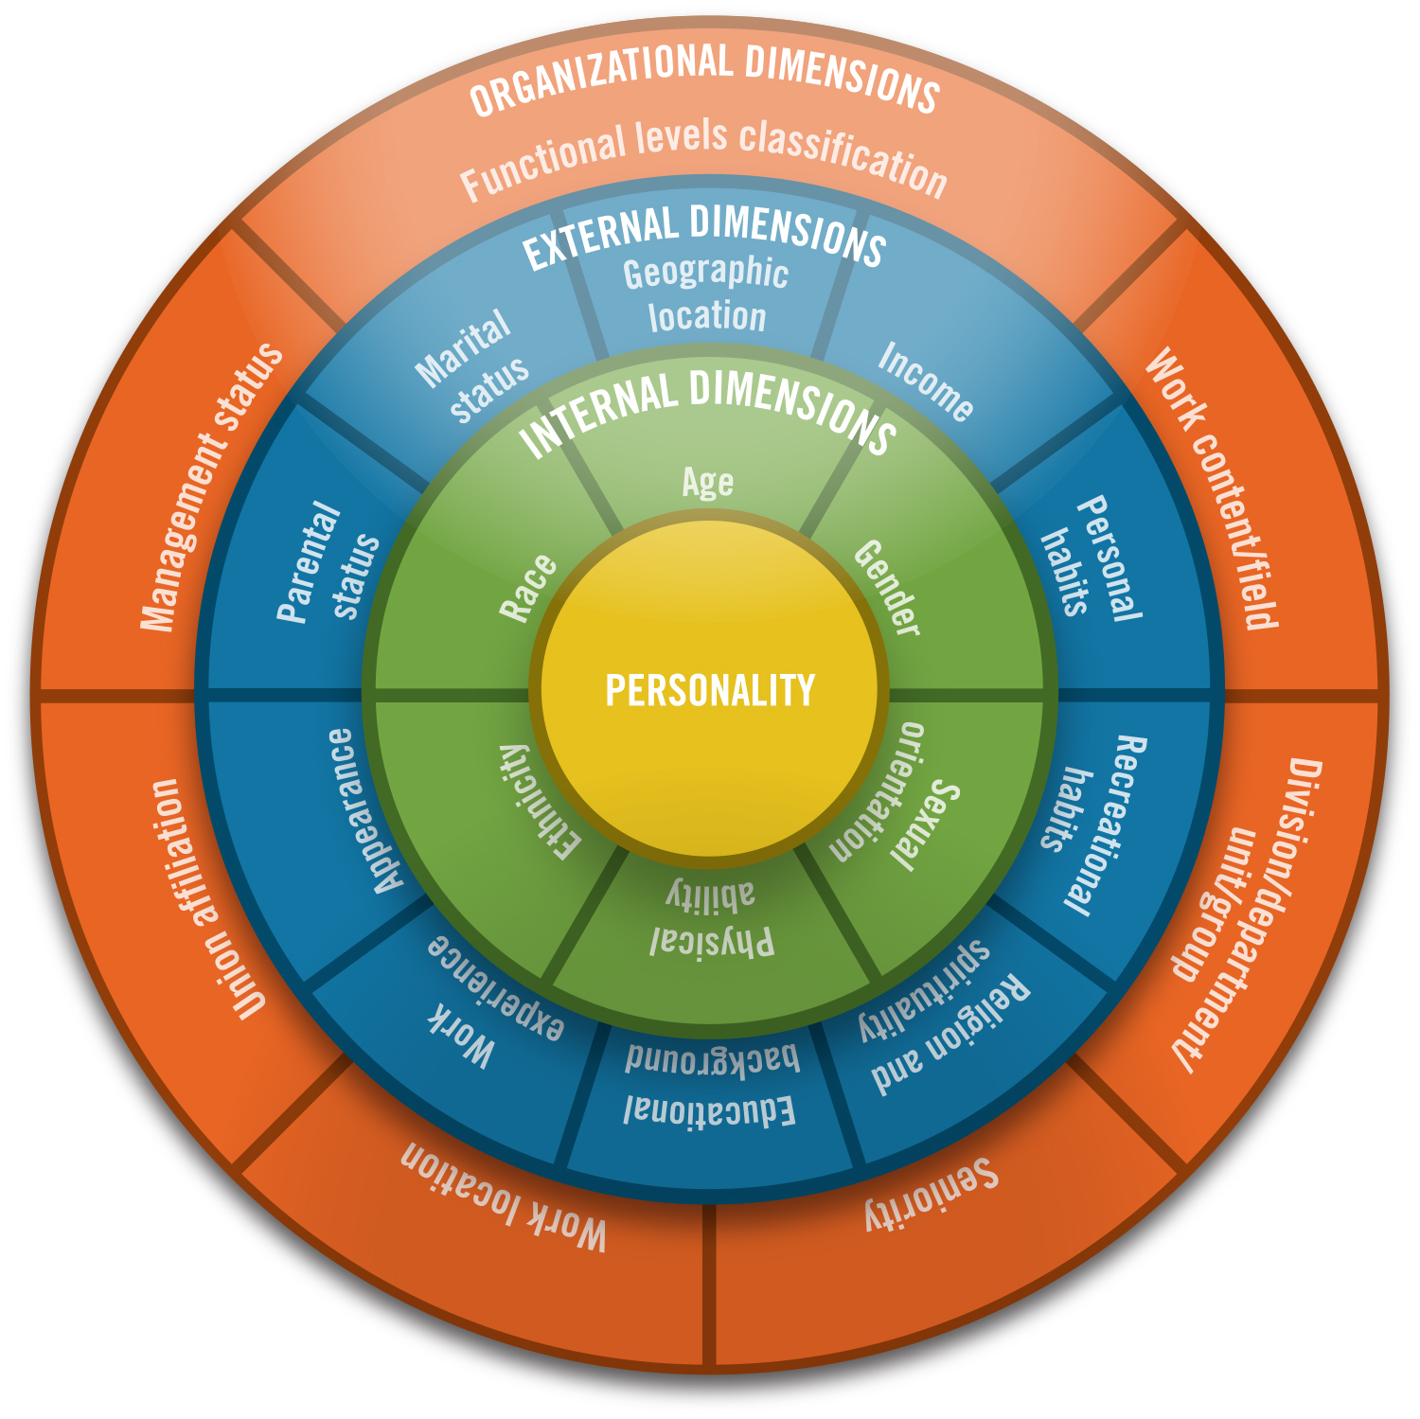
Tidelands Health
Tidelands Georgetown Memorial Hospital
Tidelands Waccamaw Community Hospital

Slide 2
Project Goal:
Domain: Diversity & Inclusion within Leadership and Governance
Improve accountability and collaboration of executives responsible for driving health equity, diversity, and inclusion initiatives.
Key Partners:
Tidelands Health Executive Board of Directors
Tidelands Health Leadership Team
South Carolina Hospital Association
The Alliance for a Healthier South Carolina

Slide 3
Objectives and Tactics
Members of the DEI Learning Collaborative attended and engaged in all sessions
Follow up meetings established to reaffirm commitment to DEI activities and initiatives both internal and external to the organization
Completed assessments from the American Hospital Association Institute for Diversity and Health Equity (AHA IFDHE)
Communicated observations/results with leadership team, executive councils and extended workgroups
Engaged the leadership team at SCHA and the Alliance for education and training resource support
Provide Emotional Intelligence training to 90% of leadership by June 2023

Slide 4
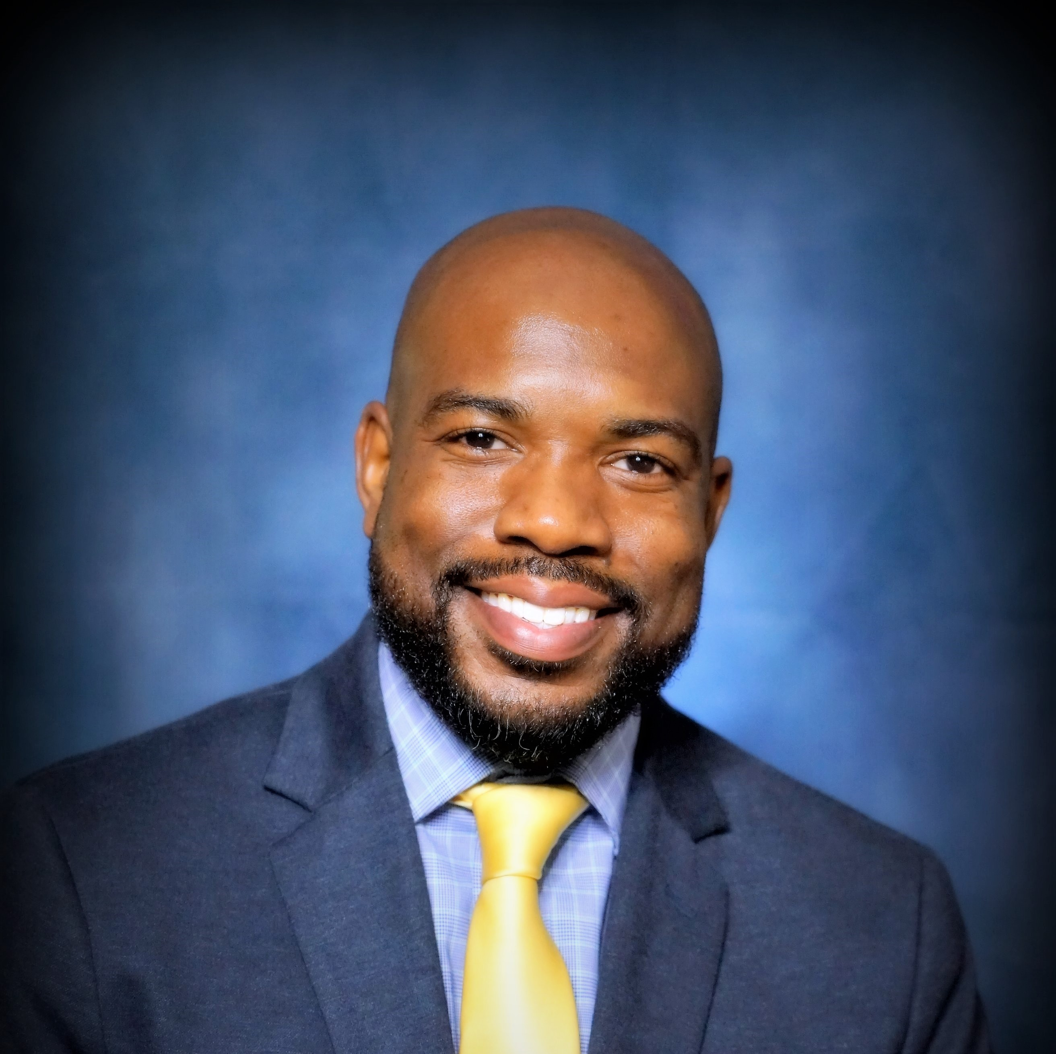
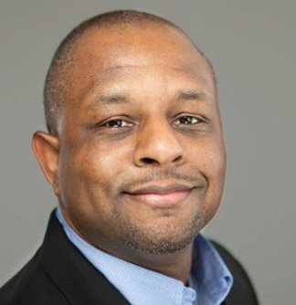
Successes
Received support from SCHA and the Alliance to secure education and training for the leadership team
Actively worked with Dr. Ira Murray, PhD and Dr. Chris Smith, PhD in the education design for the target audience: Emotional Intelligence
Preassessment of participants by facilitators-completed
Hosted leadership meeting with 134 participants in attendance- February 10, 2023
Virtual but engaging with audience participation and breakout session
Overall evaluation 4.7 % on 5 scale
Participants continue to actively apply tools shared

Slide 5
Successes Continued
Executive Coaching sessions offered to 12 leaders from a cross section of the enterprise.
Feedback has been exceptional:
“This session was so powerful. I have actionable items to work on and help me with my professional growth. I can not put into words what this conversation meant to me today.”
“I have been struggling and he helped me reframe my perspective and gave me a new outlook.”
“It was an amazing one hour full of insight, wisdom, guidance, and reflection.”
“It definitely gave me new perspectives to use going forward.”
“I will be taking pearls from this session into both my work and personal life.”
“Thank you again for the opportunity!”

Slide 6
Challenges
Limited financial resources
Selected Virtual vs. Live
Adjusted content to meet timeframe
Competing priorities involving key projects and timelines
60% of identified target audience in attendance
Placed in shared leadership site for future review
Challenge remains with limited resources to fully execute the oversight and management of goals and strategies from an organizational level

Slide 7
Continued Objectives/Tactics
Actively engage senior leadership to secure dedicated resource to develop and implement diversity program at Tidelands Health to accomplish and execute:
A structured business process for communication, education, reporting and training
Leadership
Employees
Patients
Community
A structured business process for recruitment, onboarding, engaging, retaining and exiting employee partners

Slide 8
Thank You for the Opportunity!

